Slide 1
School-wide Expectations
DMCS-Home of the Dragonflies!

Slide 2
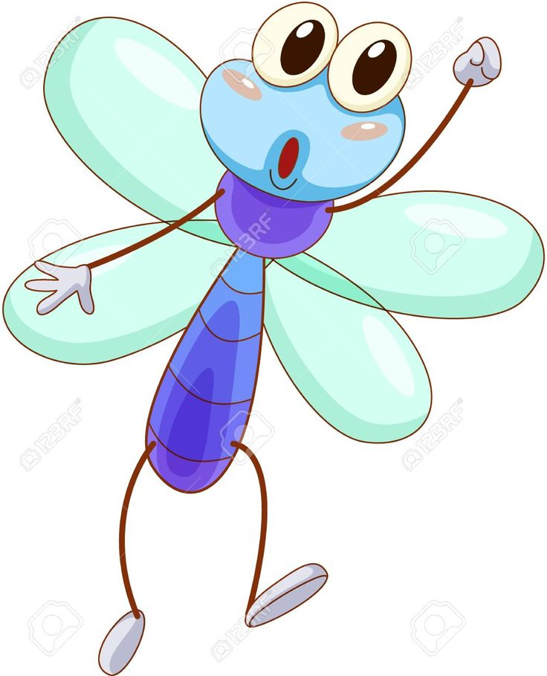
Staff will try to catch the students following the school-wide expectations
Thank you for walking in the halls.

Slide 3
Student Incentives
A staff member may give you a MERIT Buck for demonstrating good behavior
MERIT Bucks may be used as money in the Student store
The store is open during lunch

Slide 4
We Will Practice our Expected Behavior During Class

Slide 5
Our School-Wide Rules Are
Be Safe
Be Responsible Be Respectful
DMCS!
Look for the rules posted all over the school

Slide 6
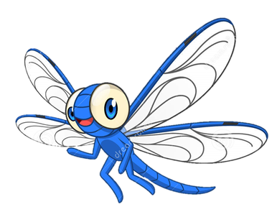
Expectations
Apply to all areas of the campus
Restroom
Office
On-Campus Supervision
Library
Playground
Physical Education
Cafeteria

Slide 7
Cafeteria Expectations
Be Safe | Be Respectful | Be responsible
Walking feet only | Allow anyone to sit next to you | Wait to be excused
Keep all food to yourself | Use quiet voices | Get all utensils, milk, etc. when first going through the line
Sit with feet on floor, bottom on bench, and facing the table | Clean your area
Keep tables and benches still | Use your manners

Slide 8
Playground Expectations
Be Safe | Be Respectful | Be Responsible
Walk to and from the playground | Play fairly | Use the bathroom appropriately
Stay within boundaries | Use kind words | Use the restroom and get drinks at recess
Be aware of activities/games around you | Follow the rules of the game
Use equipment properly | Use good sportsmanship
No play fighting or gun play
What is on the ground stays on the ground

Slide 9
Passing Areas Halls/Breezeways
Be Safe | Be Respectful | Be Responsible
Stay outside the yellow line | Hold the door open for others | Stay on sidewalks
Keep hands and feet to yourself | Use quiet voices
Walk | Smile and nod only

Slide 10
Bathroom Expectations
Be Safe | Be Responsible | Be Respectful
Keep feet on floor | Give people privacy | Flush toilet
Keep water in the sink | Use quiet voices | Return to your room promptly
Wash your hands and Clean up after yourself | No playing | Use bathrooms at appropriate times

Slide 11
Arrival and Dismissal Areas
Be Safe | Be Respectful | Be Responsible
Use sidewalks and crosswalks | Follow adult directions | Arrive on time
Wait in designated areas |  | Leave on time
Stay within boundaries |  | Walk bikes and scooters
 |  | Get a teacher’s permission to use any phone on campus

Slide 12
Assemblies
Be Safe | Be Respectful | Be Responsible
Wait for arrival and dismissal signal | Keep hands and feet to yourself | Follow school rules
 | Sit on bottom | Be honest

Slide 13
Classroom
Be Safe | Be Respectful | Be Responsible
Walk | Use quiet voices | Keep belongings organized
Use materials appropriately | Use kind words | Clean your space
Sit properly | Share | Stay on task
Ask permission to leave | Listen and follow directions | Actively listen
Follow safety procedures | Follow class routines | Be prepared and honest

Slide 14
Listen to All Staff
Staff include:
• teachers
• classroom assistants
• office staff
• campus security
• cafeteria workers
• custodians
• Guidance room staff
• vice principals
Listen to ALL instructions given by staff

Slide 15
Follow all School Expectations
Consequences for non-compliance:
Low Level Referral (LLR)
Office Referral
loss of privileges
On-campus Supervision
suspension

Slide 16
When you Need to Talk to an Adult
FIRST: talk to one of your teachers
SECOND: talk to your Dean of Students or Director

Slide 17
Who do I Talk to When I Need Help?
Any adult on campus
Assigned teacher:
TK-1:
2-3:
4-5:
6-8:

