Slide 1
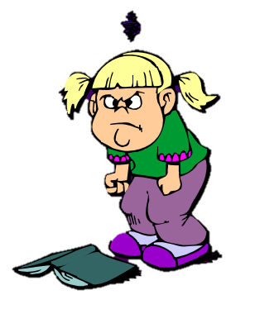
Why we De-escalate
An introduction to nonviolent crisis intervention for any student

Slide 2
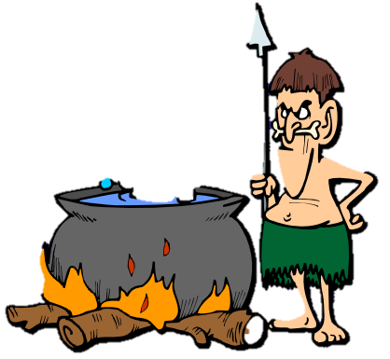
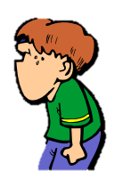
Behavior de-escalation techniques help teachers:
Intervene early and appropriately
Avoid over reacting or under reacting
Avoid Crisis

Slide 3
The Crisis Development Model
Crisis Development/Behavioral Levels | Staff Attitudes/Approaches
Anxiety | Supportive
Defensive | Directive
Risk Behavior | Physical Intervention (CPI trained only)
Tension Reduction | Therapeutic Rapport

Slide 4
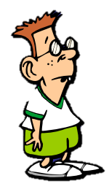
Anxiety Think Pair Share:
What does it look like?
What does it sound like?
What is an example?

Slide 5
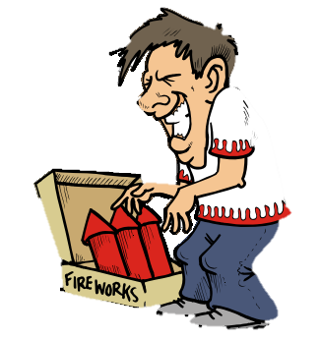
Anxiety:
Definition:
A change in behavior
We need to know the child’s “normal” behavioral patterns first
Examples:
Lack of eye contact
Hyper movement
Loss of verbal skill
Nervous ticks
Destroying things
Hoodies go up

Slide 6
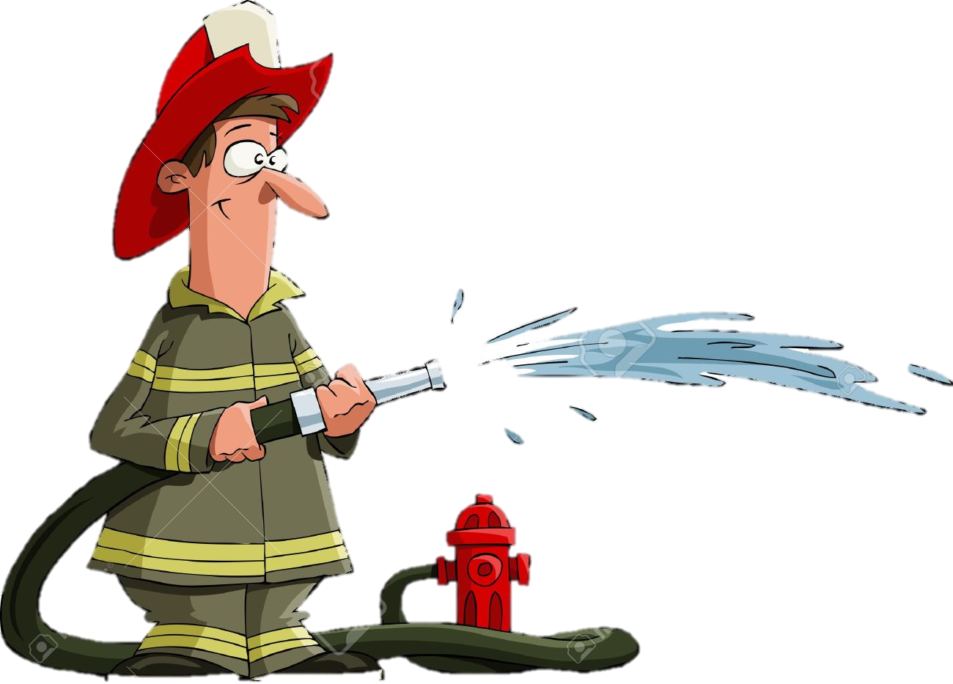
Staff Attitude/Approach to Anxiety:
Support!
An empathic, nonjudgmental approach
Touch the shoulder (depending on student)
Show empathy: I hear you, repeat their words to show you understand
Have them take a break
Have them switch activities

Slide 7
Defensive Think Pair Share:
What does it look like?
What does it sound like?
What is an example?

Slide 8
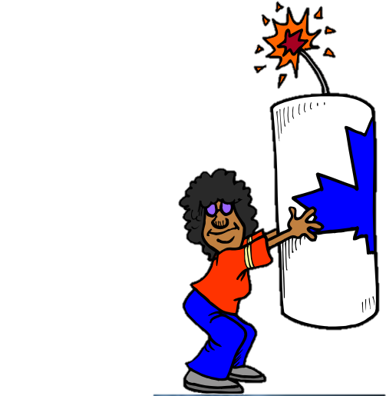
Defensive Behavior:
Watch This!
Definition:
Beginning to lose Rationality
Examples:
False Statements
Unresponsive
Blame
“Why”
Language Center Shut Down

Slide 9
Staff Attitude/Approach to Defensive Behavior:
Directive!
Decelerate and escalating behavior
They can’t hear or think normally
Examples:
Short commands- Go sit down, First…Then… This choice or that, take a break
Reduce energy- Turn away, planned ignoring

Slide 10
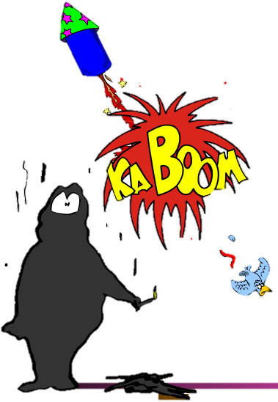
Risk Behavior
Definition:
Behaviors that may present a risk to self or others
Examples:
Throwing Things
Yelling at someone
Running Away
Hitting Self or Others

Slide 11
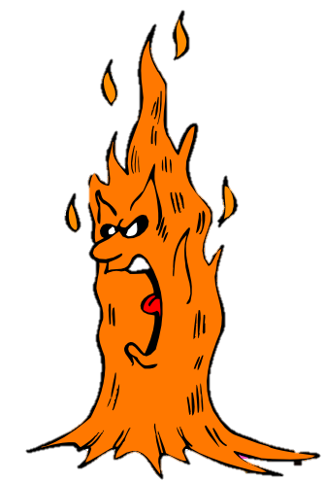
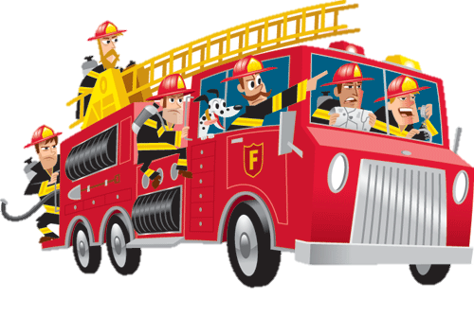
Staff Approach to Risk Behavior:
Stay Calm
Try to Keep All Kids Safe!
Call in your Admin Team!

Slide 12
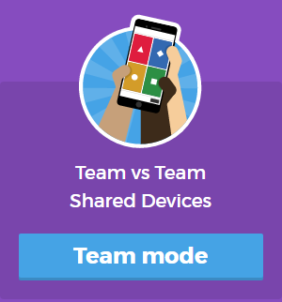
Quiz Time!
I think I’m the link
Form Grade Level Teams!
Search Kahoot! on Google Chrome
Make your team name
Enter the pin
Try to win some bragging rights!

Slide 13
Role Play Scenarios!
A student comes into your class in the morning. He has his hoodie up, he is dragging his feet, he lacks eye contact, and does not say anything after you say, “Good Morning!”

Slide 14
This student is showing anxious behavior
Staff Attitudes/Approaches
Share
Support, empathy, non-judgemental.
Touch the shoulder
Smile
Ask if everything is okay
Repeat their words to show that you hear them
Find out why they are anxious and if you can help

Slide 15
Role Play Scenario!
Students are pushing each other to start a fight!
Other students are beginning to crowd around the students who are pushing

Slide 16
These students are showing Risk Behavior
They have become a danger to themselves and to others
Your job is to attempt to stop the behavior verbally (with authority), to keep all students safe, and to call your admin team.

Slide 17
Last Role Play Scenario Today!
A student is repeatedly and challenging your authority by asking why. This student is not curious about material, she is trying to avoid work by annoying and energizing you.

Slide 18
This Student is Showing Defensive Behavior
Our job as staff is to be directive
Decelerate an escalating behavior
They are not going to listen to logic right now
DO NOT ENERGIZE!
Turn to the side, planned ignoring, continue to teach the other students
If you need to engage:
Make your voice low and slow
Give short commands and or
Give short choices (be careful, both choices must be good for you)

Slide 19
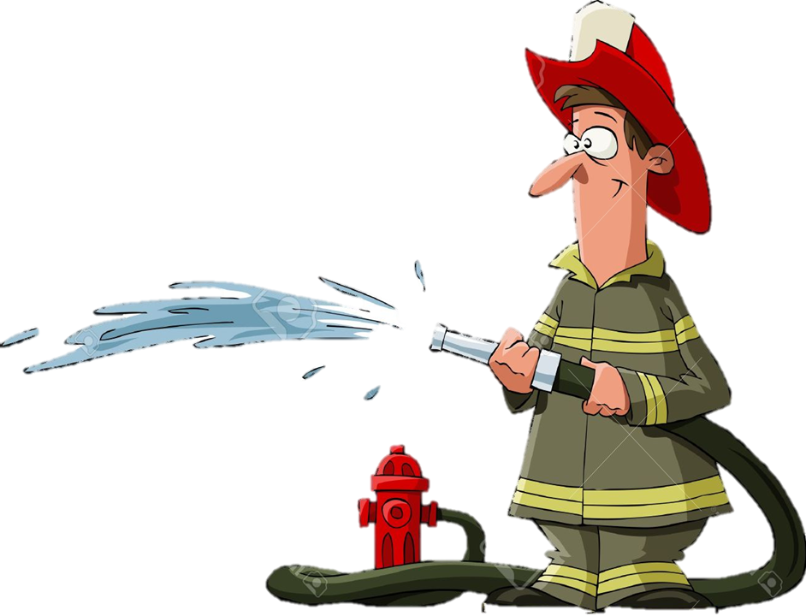
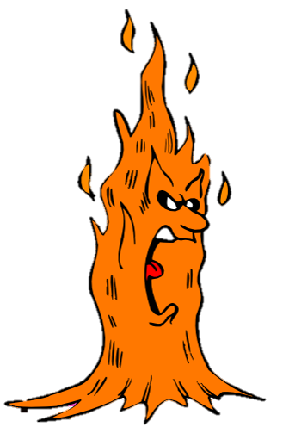
Homework!
Try it before next Wednesday
Plan on sharing the behavior, your actions, and how successful you were.

