Slide 1
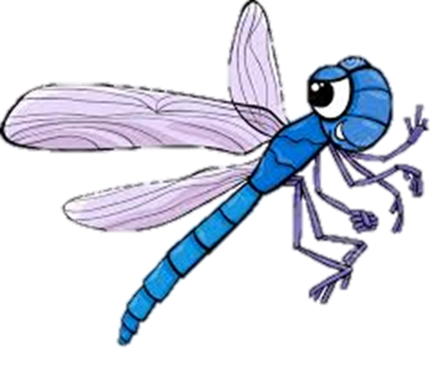
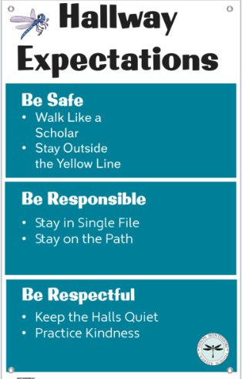
Hallway
Expectations

Slide 2
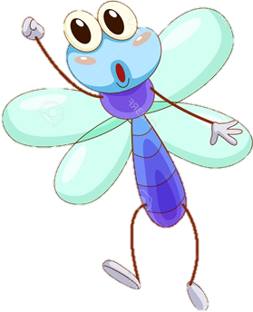
BE SAFE

Slide 3
Walk Like a Scholar
Running can lead to injury, ALWAYS walk
Walk with a purpose, get to next destination
Encourage friends to get to class on time

Slide 4
Keep Hands, Feet and Objects to Self
Walking like a scholar helps us respect everyone’s personal space
Keep your books and backpacks close to your body, so they will not bother or hurt others

Slide 5
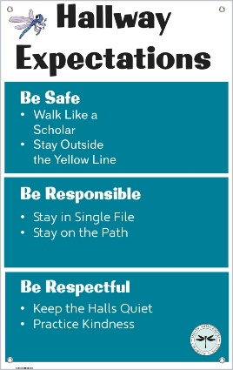
Stay outside the yellow line
The yellow lines are there to keep you from being hit by doors.

Slide 6
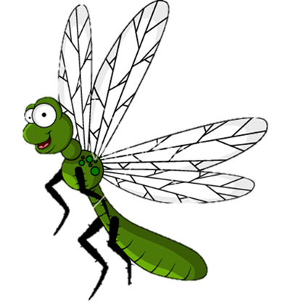
BE RESPECTFUL

Slide 7
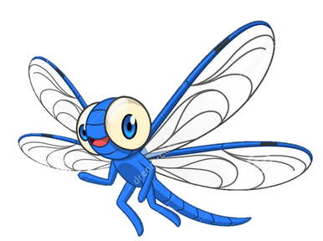
Keep the Halls Quiet–
Do not Disrupt Others
Smile and nod only
Go directly to your next location

Slide 8
When Spoken to by Adults
Stop, look & listen
Be polite
Wait your turn to speak
Answer questions
Be honest

Slide 9
Put Trash in Trash Cans
Clean-up after yourself and others
Keep our campus free of litter and graffiti

Slide 10
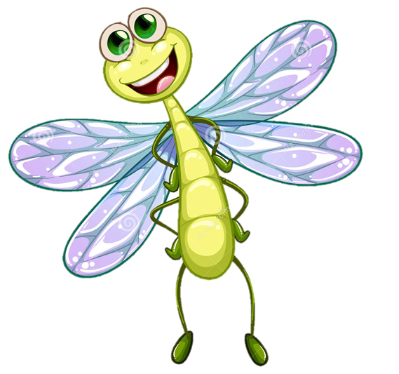
Practice Kindness

Slide 11
BE RESPO NSIBLE

Slide 12
When walking to/from
locations on campus with your class
Stay in single file
Keep a safe distance between you and the person ahead of you

Slide 13
Stay on the sidewalks
MPR
Office
Do not cut across the grass

Slide 14
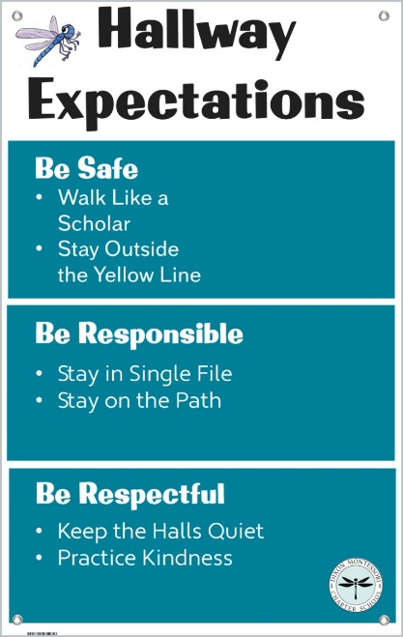
Keep Halls Clean
Finish all food and drinks in the cafeteria
This is a Food Free Zone
This is a Gum Free Zone

Slide 15
IF YOU HAVE QUESTIONS OR NEED HELP!
Talk to an adult:
Teachers
Administration
Office Staff
Cafeteria workers
Custodian
Etc., etc., etc.

