Slide 1
Dress Code Expectations

Slide 2
Make sure you have a copy of the school’s Dress Code
If you need a copy of the Dress Code, please ask for one in the office.

Slide 3
Shirts and Blouses
Exam ple:
Checklist:
Solid Color
Collar
Long or short sleeves
Button down or polo
*logos smaller than a quarter are permitted

Slide 4
Wear Pants That are Clean and Fit
Exam ple:
Checklist:
Solid color
Pants or shorts
Without rips, frayed edges or tears
Jean or Khaki material
*limited logos like a levis tag are permitted

Slide 5
Skirts, skorts, dresses and jumpers
Example:
Check List:
Solid color
No prints or patterns
Mid-thigh length or worn over tights/leggings
Blouses, shirts or collars must be worn under/with these items to fit the shirt/blouse dress code

Slide 6
Leggings, tights and yoga pants
Non-Example:
Checklist:
Leggings, tights and yoga pants are okay IF:
They are worn under a skirt, skort, dress, jumper or shorts.
They are a solid color

Slide 7
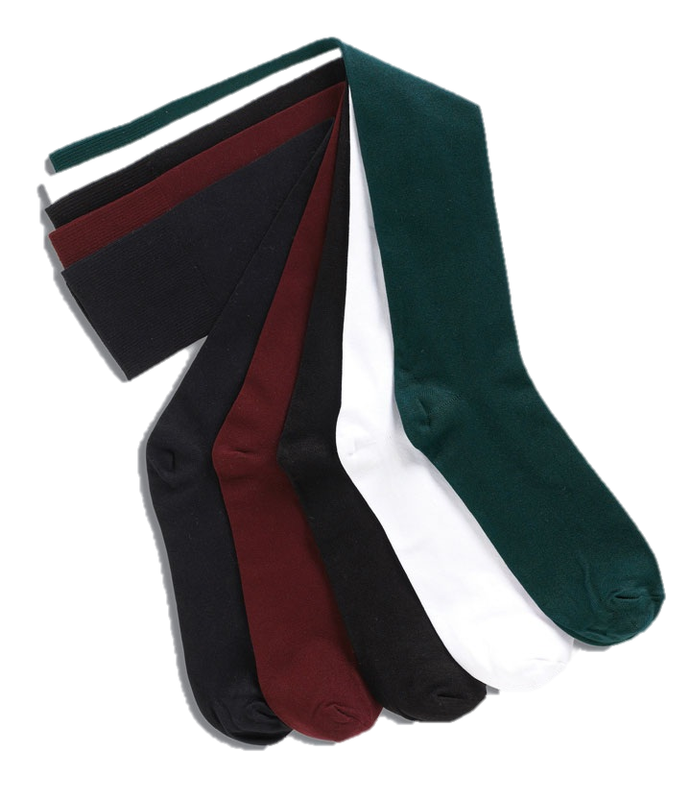
Socks
Example:
Checklist:
Solid color

Slide 8
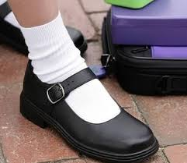
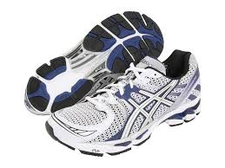
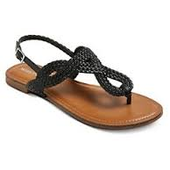
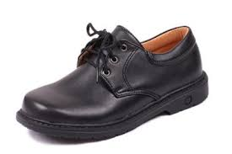
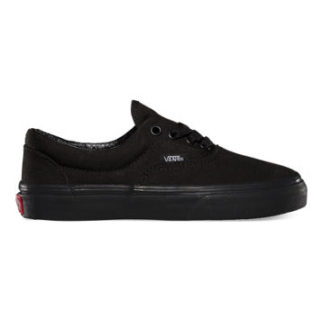
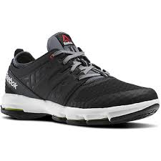
Shoes
Exam ples:
Check List:
No lights, noise, or wheels
Have a back, or a back strap
Are not flip-flops
*PE shoes must be worn for Phys Ed.
Sandals and dress shoes must be changed for PE

Slide 9
Hats
Example:
Checklist:
Hats may be worn IF
You are on the playground
You are not in class

Slide 10
Hair bows and Headbands
Example:
Checklist:
Hair bows and headbands may be worn IF
They do not distract from the learning environment

Slide 11
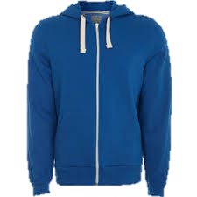
Sweatshirts and Sweaters
Example:
Check List for the classroom:
Solid color
Only DMCS school designs

Slide 12
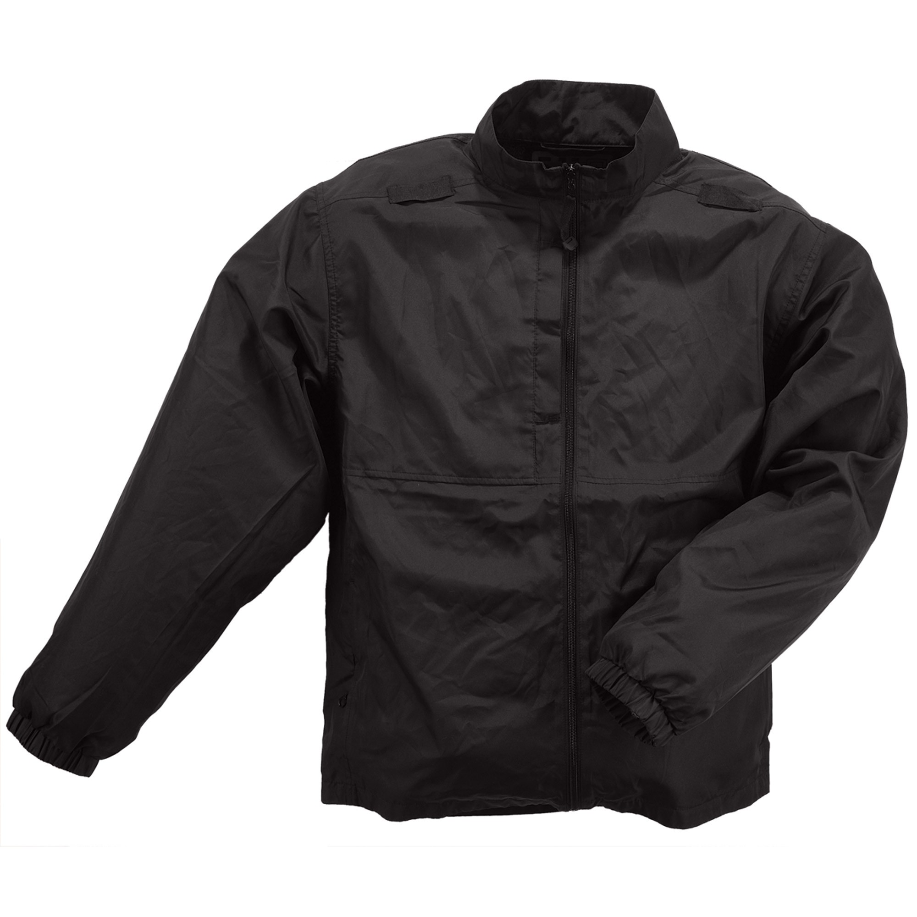
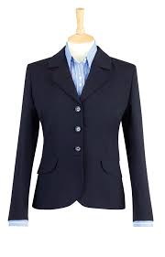
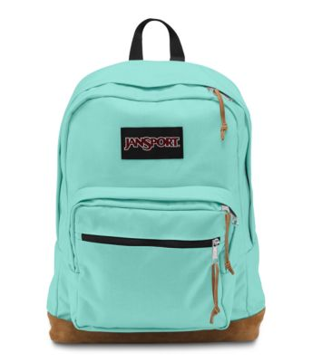
Jackets and Backpacks
Examples:
Checklist:
May be any style or color & are considered outerwear.
Jackets and backpacks must be stored in their place in the classroom

Slide 13
Exceptions and Fine Print:
As indicated by IEP, the school will modify the dress code as medically warranted.
On Friday students are allowed to wear either clothing that is in accordance with the dress code or the official school spirit shirt with jeans, hemmed jeans, shorts, a jean skirt or skort. Monday through Thursday, unless otherwise specified, students must wear clothing in accordance with the criteria outlined above.
Please note that Friday is not a “free dress” day and children may not come to school in attire other than that noted above. There will be several “free dress” or themed dress days throughout the year, coinciding with holidays or other school events and parents will be notified of those days in advance.
Frequent violators of the dress code will be asked to attend another school rather than continue to violate the DMCS dress code.
In addition, school staff may call parents if a child comes to school dressed inappropriately and ask that the parent bring a different set of clothes for the student.
Throughout the year, for various reasons, we have found that many children from all grade levels have needed a change of clothes. We recommend you supply an extra set that can be stored in the classroom should it be needed.

Slide 14
Let’s Dress for Success!

