Slide 1
Dean of Students 2016 Kickoff plan
Ben Ernest

Slide 2
Goal 1 Culture (students, staff, community)
Assist director in fostering and cultivating a positive, collaborative, and consistent school culture
Greet students and be visible during drop off, in classrooms, cafeteria, recess, and dismissal to build and model positive relationships
Drill and Enforce PBIS (Positive Behavior Interventions and Support) Matrix expectations
Staff Survey- Gather thoughts, concerns & ideas for climate improvement
Share survey results and collaborate with staff members in creating a strategic plan to improve staff culture
Parent survey- gather thoughts, concerns, and ideas for climate improvement
Discuss survey findings and create a strategic plan with the admin team to improve parent involvement
Meet with PTO and community members
Methods of communication- face to face, email, Kickboard, website
Keep our kiddos safe

Slide 3
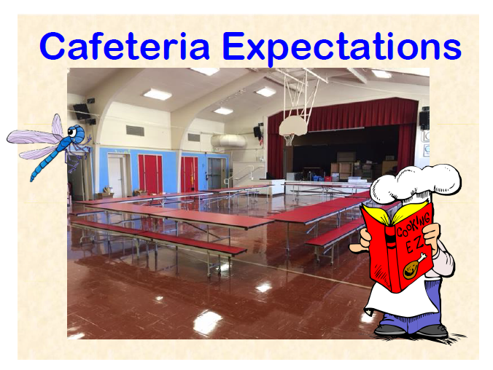

Slide 4
Example Expectations Lesson

Slide 5
Website

Slide 6
Behavior Matrix introduction

Slide 7
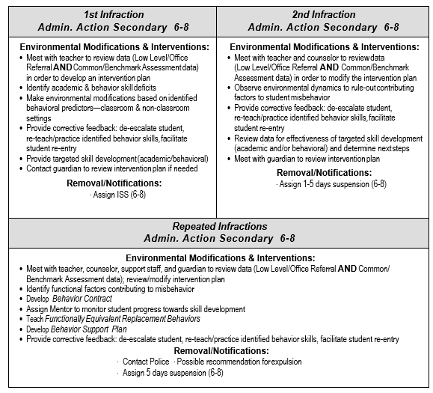

Slide 8
Goal 2 Data analysis
Assist director in establishing and building a culture for continuous improvement and adequate growth
Begin to collect Student Data with Kickboard- discipline & MERIT Bucks, behavior contracts
Find patterns- geographic, chronologic , behavior types, repeat offenders
Share data with staff
Create proactive intervention plans to disrupt negative patterns
Discover teacher patterns- Facilitate positive pattern occurrences in CPT, discuss negative patterns individually and discreetly
Track free and reduced lunch, sped, and EL populations- detect patterns and encourage pedagogically sound teaching practices

Slide 9
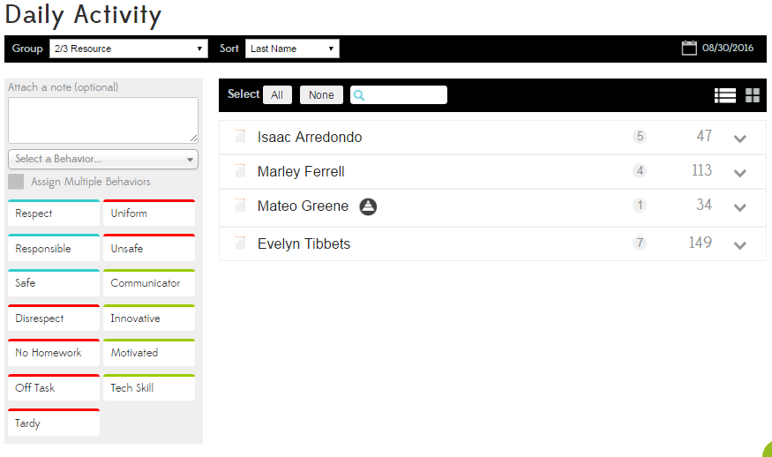

Slide 10
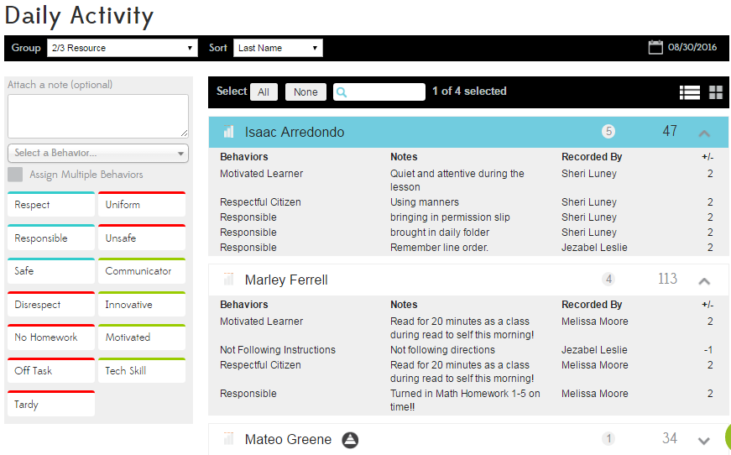

Slide 12
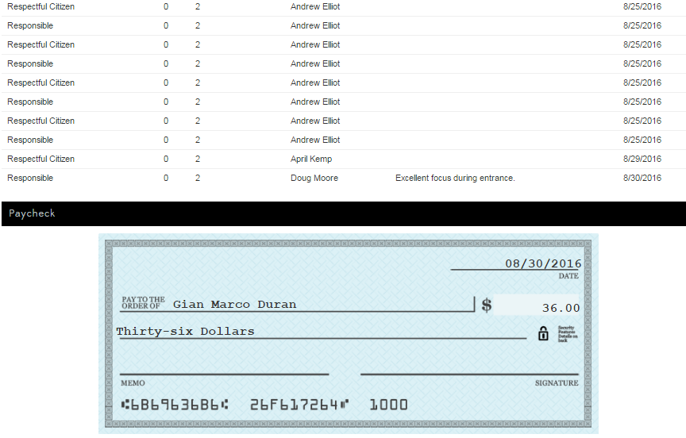

Slide 14
Data Driven Culture
Introduce PBIS with Kickboard
Kickboard data analysis with teachers at staff and CPT meetings
Facilitate a culture of collaboration and participation during staff and CPT meetings
Individual talks with teachers who are not participating
Begin to analyze Tier 2, Tier 3 intervention, support and patterns
Develop plans to assist select students in closing the behavior achievement gap early
Communicate with teachers regarding specific students and reoccurring problem behaviors so that teachers can teach and students can learn to the best of their abilities
Develop plans to structure learning environments to equip students for academic and behavioral/social success based on principles grounded in research

Slide 15
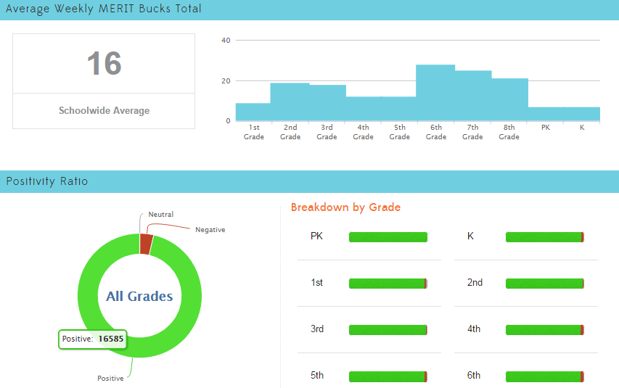

Slide 16
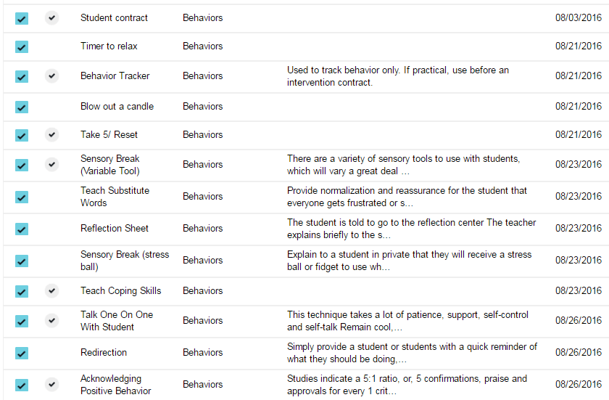

Slide 17
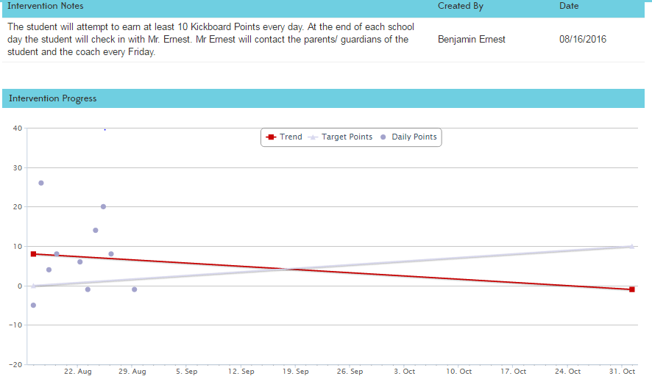

Slide 18
Questions

