Slide 1
CPI’s Top 10 De-Escalation Tips

Slide 2
Can These Tips Help Me?
Whether you work in health care, education, or any human services field, you might deal with angry, hostile, or noncompliant behavior every day. Your response to defensive behavior is often the key to avoiding a physical confrontation with someone who has lost control of their behavior.
These Top 10 De-Escalation Tips will help you respond to difficult behavior in the safest, most effective way possible.

Slide 3
TIP 1
CPI’s Top 10 De-Escalation Tips
Be empathic and nonjudgmental.
When someone says or does something you perceive as weird or irrational, try not to judge or discount their feelings. Whether or not you think those feelings are justified, they’re real to the other person. Pay attention to them.

Slide 4
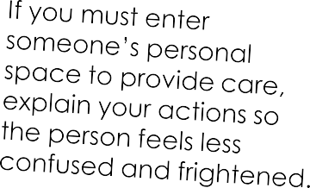
TIP 2
CPI’s Top 10 De-Escalation Tips
Respect personal space.
If possible, stand 1.5 to three feet away from a person who’s escalating. Allowing personal space tends to decrease a person’s anxiety and can help you prevent acting-out behavior.

Slide 5
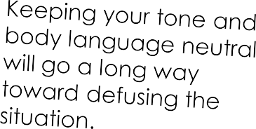
TIP 3
CPI’s Top 10 De-Escalation Tips
Use nonthreatening nonverbals.
The more a person loses control, the less they hear your words—and the more they react to your nonverbal communication. Be mindful of your gestures, facial expressions, movements, and tone of voice.

Slide 6
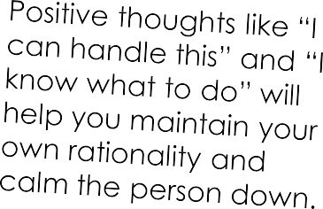
TIP 4
CPI’s Top 10 De-Escalation Tips
Avoid overreacting.
Remain calm, rational, and professional. While you can’t control the person’s behavior, how you respond to their behavior will have a direct effect on whether the situation escalates or defuses.

Slide 7
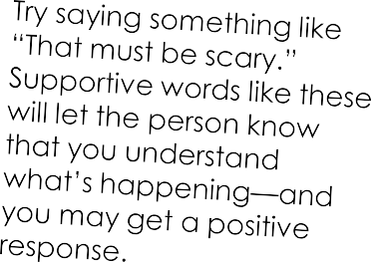
TIP 5
CPI’s Top 10 De-Escalation Tips
Focus on feelings.
Facts are important, but how a person feels is the heart of the matter. Yet some people have trouble identifying how they feel about what’s happening to them.
Watch and listen carefully for the person’s real message.

Slide 8
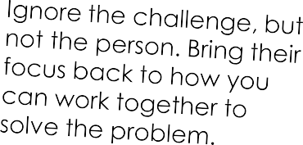
TIP 6
CPI’s Top 10 De-Escalation Tips
Ignore challenging questions.
Answering challenging questions often results in a power struggle. When a person challenges your authority, redirect their attention to the issue at hand.

Slide 9
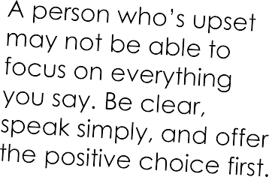
TIP 7
CPI’s Top 10 De-Escalation Tips
Set limits.
If a person’s behavior is belligerent, defensive, or disruptive, give them clear, simple, and enforceable limits. Offer concise and respectful choices and consequences.

Slide 10
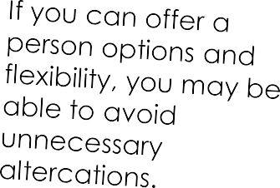
TIP 8
CPI’s Top 10 De-Escalation Tips
Choose wisely what you insist upon.
It’s important to be thoughtful in deciding which rules are negotiable and which are not. For example, if a person doesn’t want to shower in the morning, can you allow them to choose the time of day that feels best for them?

Slide 11
TIP 9
CPI’s Top 10 De-Escalation Tips
Allow silence for reflection.
We’ve all experienced awkward silences. While it may seem counterintuitive to let moments of silence occur, sometimes it’s the best choice. It can give a person a chance to reflect on what’s happening, and how he or she needs to proceed.

Slide 12
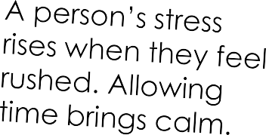
TIP 10
CPI’s Top 10 De-Escalation Tips
Allow time for decisions.
When a person is upset, they may not be able to think clearly. Give them a few moments to think through what you’ve said.

Slide 13
Thank You!
We hope you found these tips helpful. Please feel free to share this resource with a friend or colleague.
Want to see how CPI training can help you improve your de-escalation skills?
Watch this video
Got questions? We can help!
Give us a call at 888.426.2184 or email
info@crisisprevention.com
crisisprevention.com
© 2014 CPI. All rights reserved.

