Slide 1
Now Showing
Classroom
Management
Before the Screaming Starts

Slide 2
Behavior
Pre-teach expected behaviors
Pre-plan “consequences” and evaluate effectiveness
Frequently reinforce the right behaviors
Address behaviors while they are small (slow is fast)
Utilize peer attention to your advantage

Slide 3
Effective Teachers
Have well-thought-out and structured activities for EVERY activity
Teach the procedures often
Rehearse procedures until they become class routines
Re-teach procedures when you have the opportunity
Acknowledge when procedures are followed

Slide 4
Procedures
Entering the classroom: on-time, tardy
Getting to work immediately on a starter
Being dismissed from the class
Call to attention
Participating in class discussions
Obtaining pencil, paper, etc
Indicating understanding

Slide 5
Procedures (student how to)
Listen to directions for assignments
Change Groups/ seats
Start Planners and notebooks
Know the schedule
Pass in papers
Collect graded work
Get materials for class quickly and quietly

Slide 6
Procedures
Expectations outside of your classroom
Arrival, dismissal
Office
Restroom
Lunch

Slide 7
Effective Teachers
Teach the STUDENT- not the subject or grade level
Maximize learning minutes with great lessons and great management
Have students earn achievement (grade, KB Points)
Keep students actively engaged in learning by hook or crook

Slide 8
Supporting Academic Deficits
Team Teach, direct teach, PBL, small group instruction… Depending on learning style, change teaching modality
ENGAGE! Trick them into being interested
Targeted skill development based on iReady and other data
Room 6

Slide 9
Classroom Schedules
Clearly define and post your classroom schedule
Prepare students for changes: assembly, guest speaker…
Stick to the schedule and make it a routine

Slide 10
Points to Ponder
I intentionally teach all classroom expectations
I re-teach expectations after reviewing student behavior patterns
My STUDENTS are interested in what I’m teaching
My students are generating brain sweat
I don’t complain that students cant learn, I do something about it

Slide 11
So What IS Classroom Management?
All the things a teacher does to organize students, space, time, and materials so that instruction and student learning can take place.
Students want a well-managed classroom...because a well-managed classroom gives students security.

Slide 12
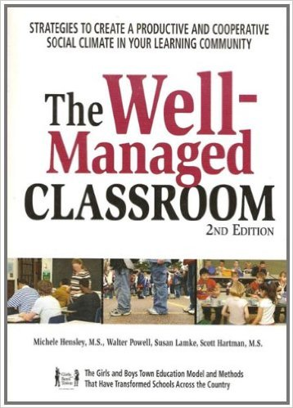
Credits:
The First Days of School: How to Be an Effective Teacher (Book & DVD)4th Edition
by Harry K. Wong (Author), Rosemary T. Wong (Author)
Transforming the Difficult Child: The Nurtured Heart Approach Paperback – April, 1999
by Howard Glasser (Author), Jennifer Easley (Author)
4.6 out of 5 stars 196 customer reviews
The Well-Managed Classroom: Strategies to Create a Productive and Cooperative Social Climate in Your Learning Community Paperback – July 23, 2007
by Michele Hensley (Author)

