Slide 1
Now Showing
Classroom
Management
Before the Screaming Starts

Slide 2
Presentation Expectations
Honor each other’s time
Actively Listen:
Turn off laptops, put away cell phones, avoid side conversation, put aside other work
Interact Professionally
Avoid sarcasm, eye-rolling, blaming students and families for systemic failures

Slide 3
Based on review of 11,000 studies spanning 50 years, researchers determined the most important factor governing student learning is…
Classroom Management!
Teacher! I don’t have a pencil!!!

Slide 4
What IS Classroom Management?

Slide 5
Effective Teachers:
Cultivate a positive reputation
Regularly communicate with students and parents
Greet students daily

Slide 6
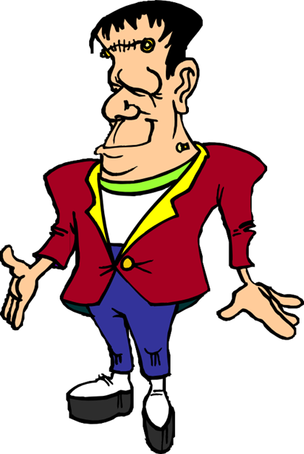
Establish Yourself as a Reinforcer
Know students on a personal level
Be direct and then patient
Energize positivity with positivity
De-energize negativity with a quick consequence, or planned ignoring
Let them know you care by asking questions
Notice small accomplishments
Praise appropriate behaviors loudly

Slide 7
Making the Most of Praise
Make eye contact, make it personal
Use behaviorally specific language
Provide immediate feedback (vocal, Kickboard)
Acknowledge appropriate behavior more than negative behavior

Slide 8
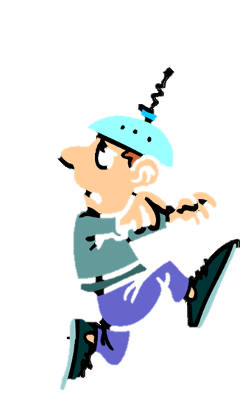
Questions to Consider
Would my students describe me as a compassionate teacher?
Do I communicate empathy, understanding, concern, and dignity to my students?
How well do I know my students?
Are there some students who I know very little about?
Outside of school, what do my students like and dislike?
Do I praise my students more than I correct them?
Would my students describe me as genuine, insincere, or indifferent?
Do I participate in school-related activities?
Is my body language welcoming and relaxed or cold and tense?
Do I see my students as interesting individuals, or do I dread seeing them?

Slide 9
Tools to Decrease Anxiety
Prepare, prepare, prepare
Teach and reinforce Classroom expectations and procedures
Prepare effective, engaging, meaningful work
Maximize proximity:
Students and materials
Prepare areas in the classroom for different uses (quiet rug, tables for work, outside for messy projects, etc.)

Slide 10
Proactively Structure the Environment
Space
Time
Materials
Interactions

Slide 11
Effective Teachers
Clearly state positive expectations
Create a climate of positive expectations for all
Establish effective management techniques that fit their style and their students needs
Set a goal to achieve great lessons and deep learning

Slide 12
Teach Expectations
Introduce the expectation before you need it
Provide rationale
Model what the behavior “looks like” (positive example only)
Find practice opportunities to re-teach model behavior
Provide specific feedback
Acknowledge students who demonstrate the skill
Use prompts and model behavior

Slide 13
Classroom Rules
Post your rules (3-5) in a prominent location
Example: Be Respectful, Be Safe, Be Responsible, Be Kind
Acknowledge rule-following behaviors loudly
Refer to the rules often
Link behavior to consequences (+&-)
Embed into all interactions

Slide 14
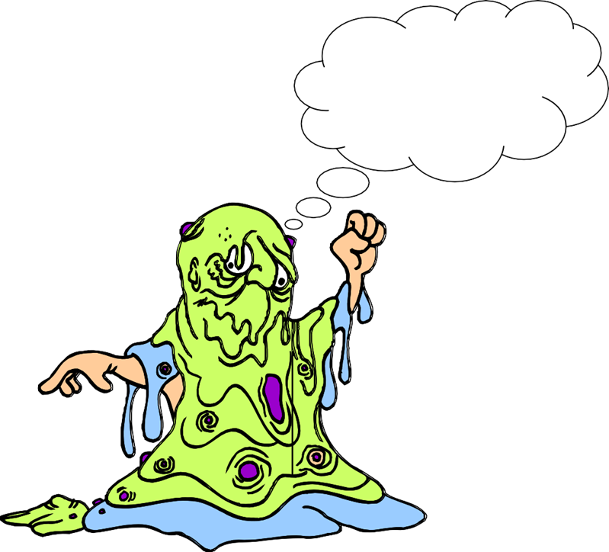
Classroom Roles
I sure hope she lets me clean the whiteboard this week!
Monitors: Door, light, plant, pet
Cleaning: White board
Supplies: Pencils, Paper
Librarian: Book stacker
Flag Salute leader
MERIT Salute
Runner
Chairs
Phone

Slide 15
Points to Ponder
I define and post all expectations
I intentionally teach all classroom expectations
I re-teach expectations after reviewing student behavior patterns
I have well established rules and procedures
I arrange my room to minimize distractions (environmental)
I routinely prompt and re-teach expectations

Slide 16
Effective Teachers:
Manage their classrooms
rather
than
control their classrooms

Slide 17
So What IS Classroom Management?
All the things a teacher does to organize students, space, time, and materials so that instruction and student learning can take place.
Students want a well-managed classroom...because a well-managed classroom gives students security.

Slide 18
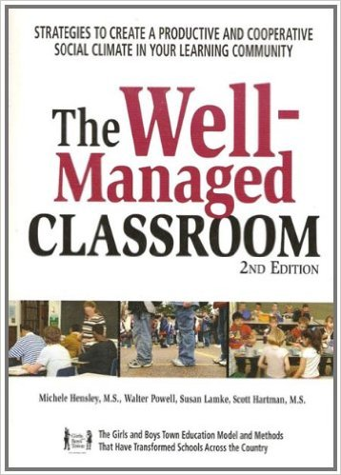
Credits:
The First Days of School: How to Be an Effective Teacher (Book & DVD)4th Edition
by Harry K. Wong (Author), Rosemary T. Wong (Author)
Transforming the Difficult Child: The Nurtured Heart Approach Paperback – April, 1999
by Howard Glasser (Author), Jennifer Easley (Author)
4.6 out of 5 stars 196 customer reviews
The Well-Managed Classroom: Strategies to Create a Productive and Cooperative Social Climate in Your Learning Community Paperback – July 23, 2007
by Michele Hensley (Author)

