Slide 1
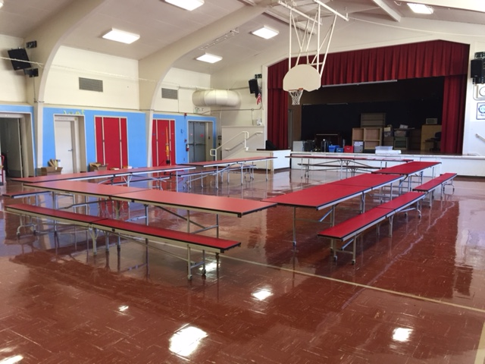
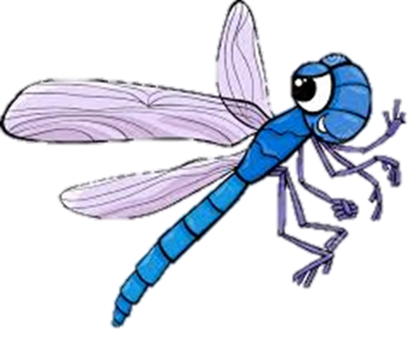
Cafeteria Expectations

Slide 2
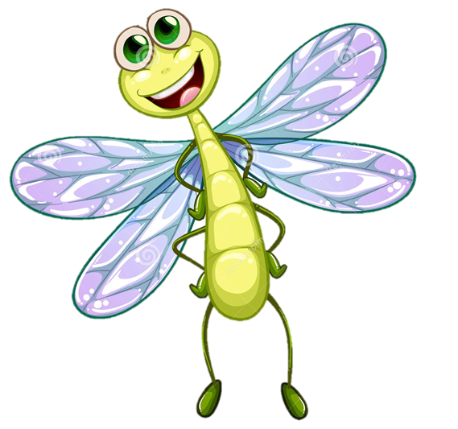
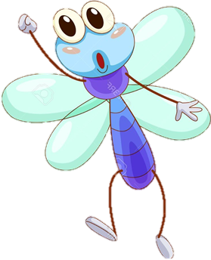
Being RESPECTFUL
Means:
Allowing anyone to sit next to you

Slide 3
Use your manners
ƒ Use quiet voices
ƒ Clean your area
Make sure to clean up after yourself
Okay

Slide 4
Clean Up Your Area
ƒ Pick up trash from TABLES
ƒ Pick up trash from the GROUND
ƒ Put all trash in trash cans

Slide 5
Talk…Avoid Yelling
ƒ Use appropriate VOLUME and LANGUAGE
ƒ Keep voices down: other students are still in class
ƒ The lunch area is for eating – not playing

Slide 6
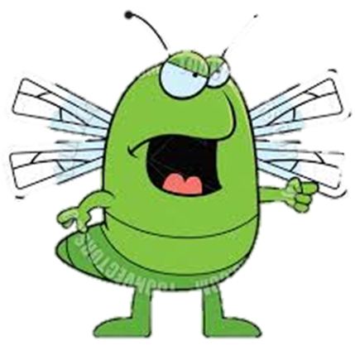
Being SAFE Means:
Not likely to cause any physical injury or harm.
Be Careful

Slide 7
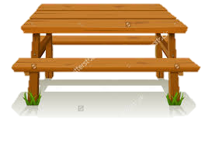
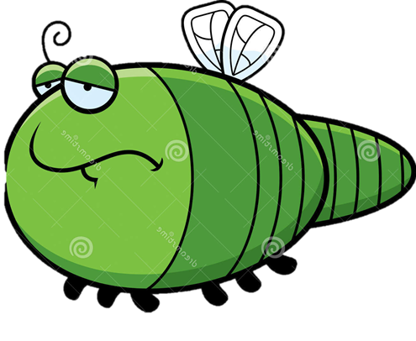
Be SAFE:
Walk in the Cafeteria
Sit with your feet on the floor, bottom on the bench, and facing the table
Keep tables and benches still

Slide 8
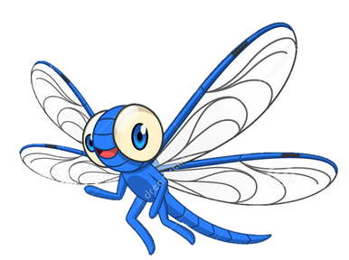
Being RESPONSIBLE
Means:
To behave in a sensible way so other people will trust you.

Slide 9
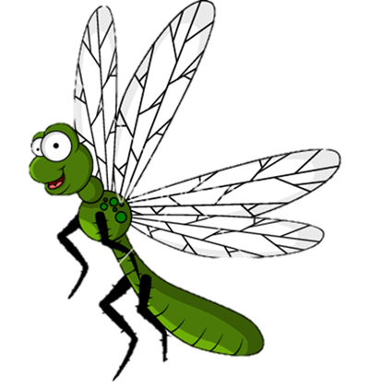
Be Responsible
ƒ Wait to be excused
ƒ Get all utensils, milk, etc. When first going through the line

Slide 10
Keep Your Food OFF the Ground
ƒ If you don’t want a food item
don’t take it or
throw it in the trash
ƒ Keep food on the tables
ƒ Food is for eating and absolutely nothing else

