Slide 1
Dean of Students Board Report
October 2017

Slide 2
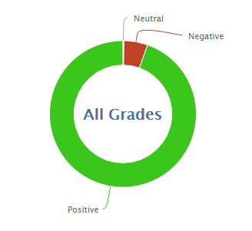
1,268
16,128
92.7% Positive for the month of October so far
94.7% was the average for October last year

Slide 3
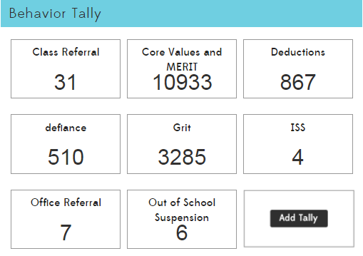

Slide 5
MERIT Rallies
October is Respect month.
Leadership has formed and has completed the rally slides
2nd Grade is singing “RESPECT”
Three students from leadership will run the rally, all students from leadership will participate in some way
MERIT Store
First day is Wednesday, October 18
Leadership students will travel to classes to run the store in house
MERIT Checks are printed and have been sent home by most teachers
Most teachers have created MERIT Store items

Slide 6
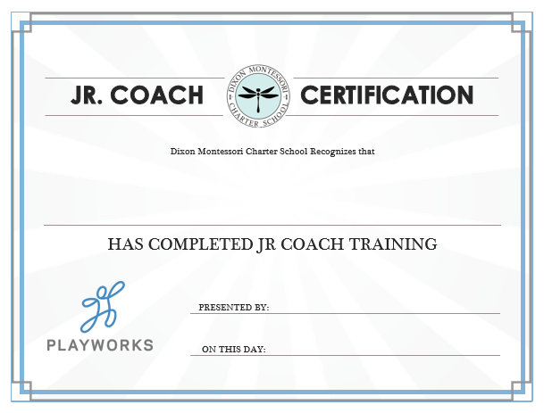
PBIS-Playworks Recess Implementation
Mr. Riemer and Ms. Kim are doing an amazing job as PE teachers and coaches
Jr. Coaches were brought to the recess program in October
❏ Every Middle School Student signed up
❏ 20 Students have taken the course and passed the quiz so far
❏ Mr. Riemer is teaching the Playworks games in PE
We are using a Google Doc to assign leadership students to recess times.

