Slide 1
Dean of Students Board Report
September 20- October 20

Slide 2
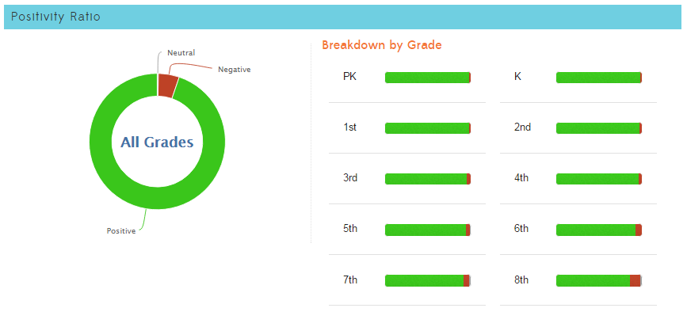
1,431
25,707
94.7% Positive from 9/20 through 10/20/2016

Slide 3
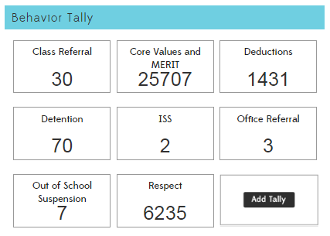
4
12

Slide 4
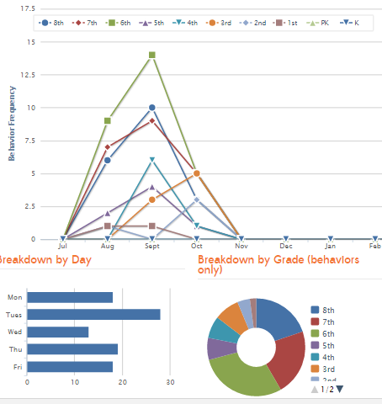
Referrals
30 Class Referrals
12 Office Referrals
13 total referrals earned by 5 students
Tuesday continues to have far more referrals than any other day
Middle school has more than elementary, 2nd and 3rd grade have increased
Most happen at recess or PE, followed by a specific classroom

Slide 5
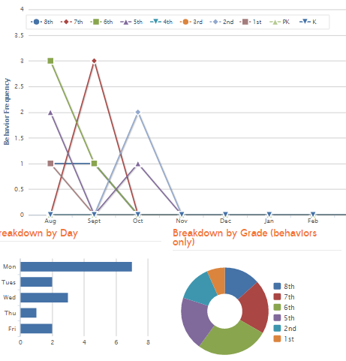
In School Suspension/ Skills Academy
4 total incidences of ISS
One student has 2 ISS
Most ISS continues to happen on Monday
Most ISS is 5th and 3rd grade
Most ISS behavior occurs in PE and in class

Slide 6
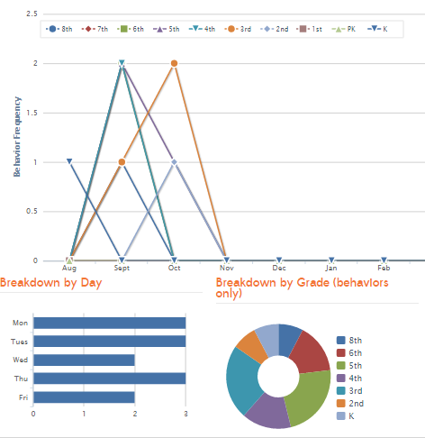
Out of School Suspension
7 out of school suspensions total
5 students suspended total
Class activity is the largest factor this month
Dodge-ball in P.E.
Work that frustrates a student

Slide 7
Interventions (student)
6 students are currently on behavior intervention plans
1 student is showing improvement
3 students are neutral, or are not showing improvement
2 students are showing more negative behavior than the beginning of the behavior plan
2 students are working continuously in the garden/DMCS beautification on Wednesdays
Several others volunteer

Slide 8
Interventions (Environment/Situation)
Middle school line time reduced, middle school lines moved
Middle school lunch expanded to MPR and outside
Dodge-Ball and other aggressive games removed from PE for specific classes

Slide 9
Student Store
Leadership has opened the student store
Teachers have provided store items
Students run the store with Teacher supervision
Students are taking pictures of their progress to send to Kickboard, and to use in the yearbook
Students are working on store schedule time and dates, as well as a lesson on expected behavior at the store
Teachers are working on the store
Most teachers have store items ready
All teachers have printed checks, and converted to MERIT Bucks

Slide 10
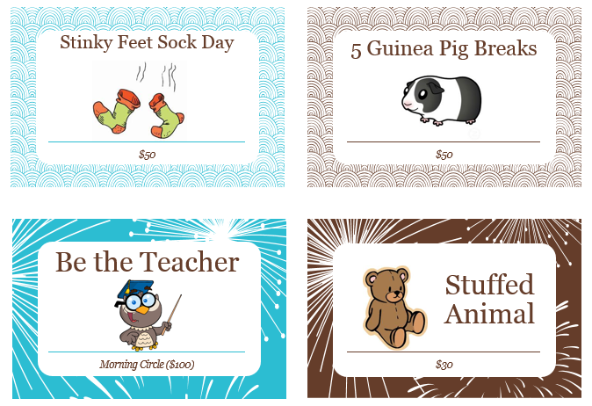
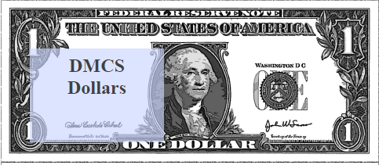
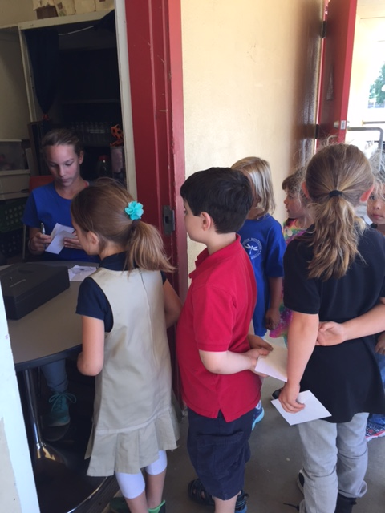
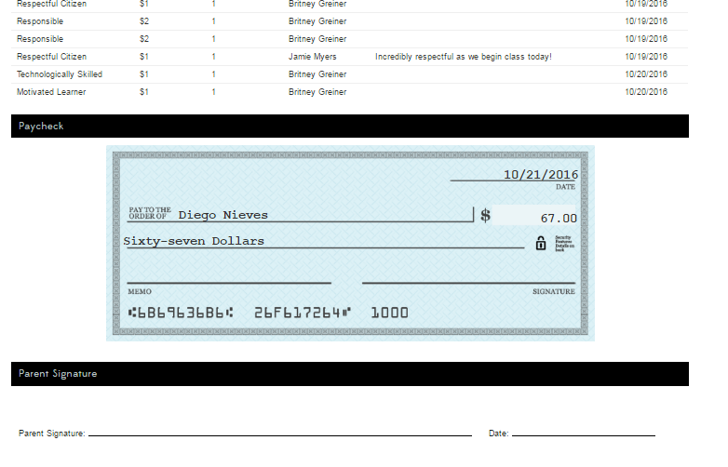
Student Store

Slide 11
Student Rally (November is Gratitude Month)
Elementary
MERIT rally will consist of a positive message on Gratitude
Kickboard Bucks for Gratitude will be added to the program and worth double
Awards for Respect will be given
Leadership will run a skit on Gratitude
Middle School (Leadership’s plan so far)
Grateful song walk in music
Caught being good drawing
Positive message on the psychological effect of Attitude of Gratitude
Awards for Respect with Price is Right music (students stay in front for game)
Teacher Mummy Wrap with “Thriller”
Kickboard Bucks for Gratitude will double
Monster Mash walk out music

