Slide 1
Dean of Students Board Report
November 2017

Slide 2
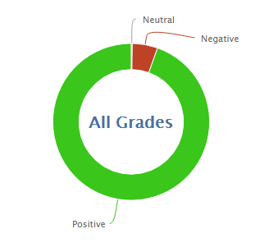
888
10,574
92.3% Positive for the month of November so far
94.3% was the average for November last year

Slide 3
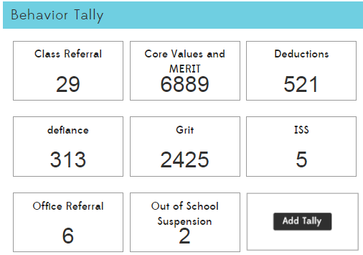

Slide 5
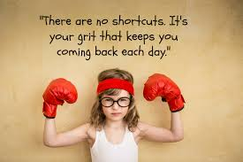
MERIT Rallies
November had no rally- The November character trait is respect.
December 15 is the Hard Work and Determination (GRIT) Rally.
We will recognize academic excellence at the December rally including students who met goals on iReady and Honor Roll students
MERIT Store
Classes will run the MERIT store in house with leadership and or parent help

Slide 6
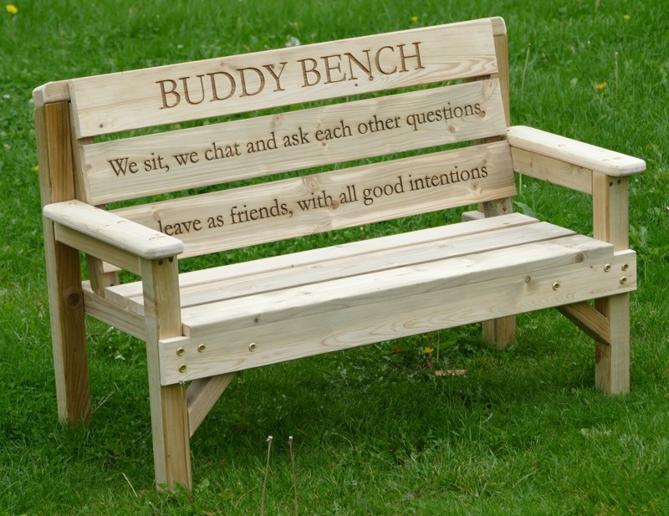
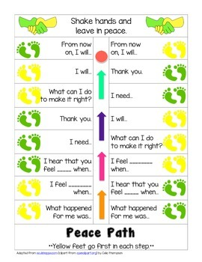
PBIS- Buddy Bench and Peace Path
❏ Student led project (one middle school lead with several elementary helpers)
❏ Purpose of Buddy Bench
Student project
Purpose of peace path

Slide 7
PBIS-
Team meeting tomorrow
CPI training tomorrow for three members of PBIS

