Slide 1
Dean of Students
Board Report
October 20- November 9

Slide 2
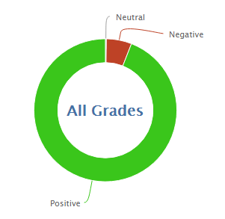
781
12,823
94.3% Positive from 10/20 through 11/9/2016

Slide 3
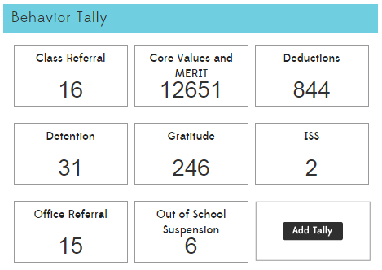

Slide 4

*

Slide 5
Interventions (student)
5 students are currently on behavior intervention plans
  1 student is showing improvement
  2 students are neutral, or are not showing improvement
  2 students are showing more negative behavior than the beginning of the behavior plan
3 students are working continuously in the garden/DMCS beautification on Wednesdays
  Some others volunteer or are assigned

Slide 6
PBIS and MERIT
PBIS
  PBIS Team Meeting to discuss environmental and functional changes in the following categories
    Referral procedures, Kickboard System, Universal Expectations, School-Wide Skills Instruction, School-Wide Acknowledgement System, Data-Based Decision Making, Communication Systems, Available PBIS Training, Interventions and consequences, Behavior Plans, and Common Areas.
MERIT
  The Great Kindness Challenge
  Kickboard Bucks for Kindness will be added to the program and worth double

Slide 7
