Slide 1
Dean of Students Board Report
January 2018

Slide 2
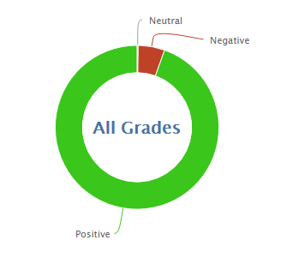
1,365
11,241
89.2% Positive for the month of January so far
94.8% was the average for January last year

Slide 3
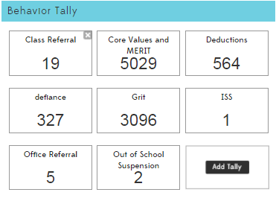
8 from one 5th grade student, 8 from k-1 classes

Slide 5
Class Referrals 16/17 vs. 17/18

Slide 6
Office Referrals 16/17 vs. 17/18

Slide 7
In-School Suspension 16/17 vs. 17/18

Slide 8
Out of School Suspension 16/17 vs. 17/18

Slide 9
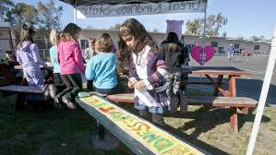
MERIT Rallies
January 22 was the Kindness Kickoff
This month we will recognize
Outstanding students for Kindness
Kindness Ambasadors
MERIT Store
Classes will run the MERIT store in house with leadership and or parent help

Slide 10
PBIS-
Rework behavior tracking: Kickboard and Behavior Plan to help fit three groups
K1, 4-6, and Middle School
Paraprofessionals
Indoor Recess with Playworks
Searching for Trainings

