Slide 1
Dean of Students Board Report
August and September

Slide 2
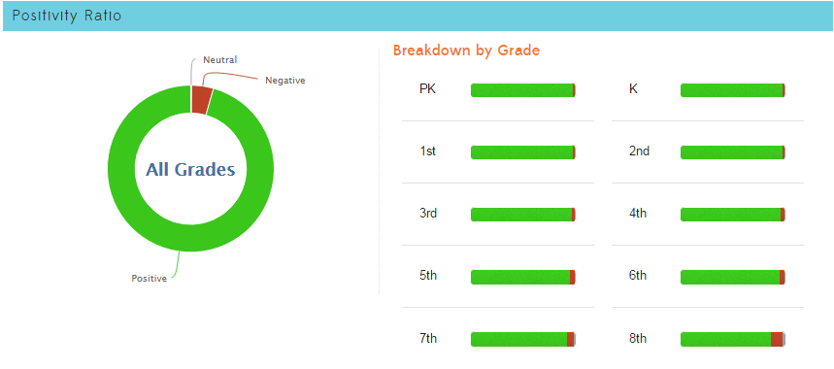
1,481
33,568
95.7% Positive from the first day of school until 9/22

Slide 3
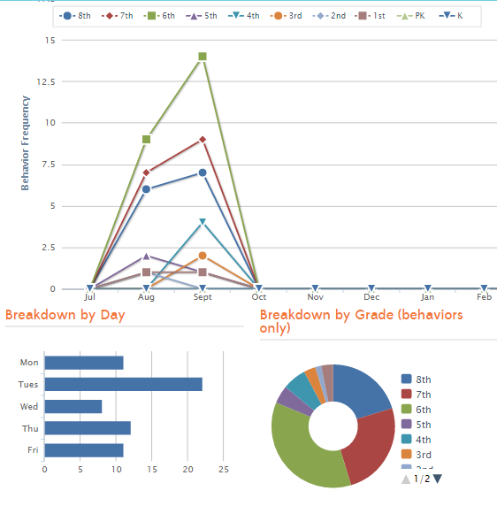
Referrals
64 minor offense referrals
28 referrals earned by 5 students
Tuesday has far more than any other day
Middle school has more than elementary (6th has most)
Most happen after middle school lunch and in line

Slide 4
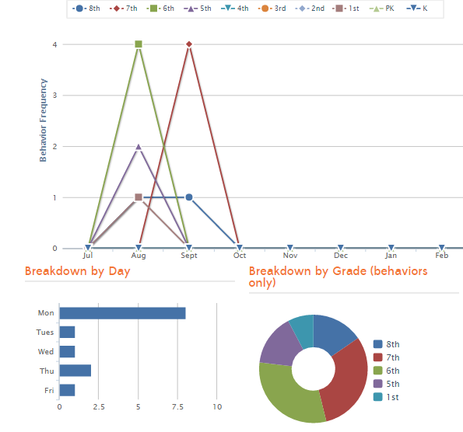
In School Suspension/ Skills Academy
13 total incidences of ISS
5 students have 7 of the ISS total
Most ISS happens on Monday
Most ISS is 6th and 7th grade
Most ISS behavior occurs after middle school lunch or in line

Slide 5
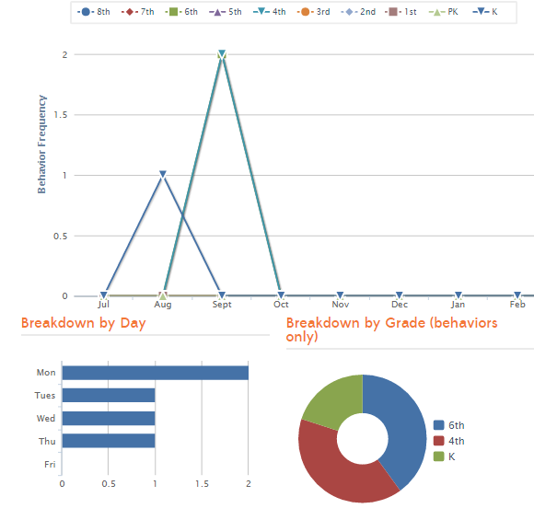
Office Suspension
5 out of school suspensions total
4 students suspended total
Most happen

Slide 6
Interventions (student)
5 students are currently on behavior intervention plans
2 students are showing improvement
1 student is neutral
2 students are following their previous path

Slide 7
Interventions (Environment)
Middle school line time reduced
Middle school lines moved
Middle school lunch expanded to MPR and outside

Slide 8
Student Store
Leadership is currently working on a student store
Students are sending out emails to teachers asking for student store items
Students are cleaning out the store area
Students are taking pictures of their progress to send to Kickboard, and to use in the yearbook
Students are working on store schedule time and dates
Teachers are working on the store
Most teachers have store items ready
All teachers have printed checks, and converted to MERIT Bucks

Slide 9
Student Rally (October is Respect Month)
Elementary
MERIT rally will consist of a positive message on respect
Kickboard Bucks for respect will double
Awards for Responsibility will be given
Leadership will…
Middle School (Leadership planned)
RESPECT walk in music
Life size hungry hungry hippos with “I can make your hands clap”
Positive message on respect
Kickboard Bucks for respect will double
Awards for Responsibility
Teacher skit
RESPECT walk out music

