Slide 1
Dean of Students Board Report
December 2017

Slide 2
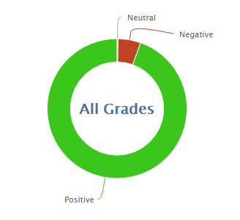
824
8,538
91.2% Positive for the month of December so far
94% was the average for December last year

Slide 3
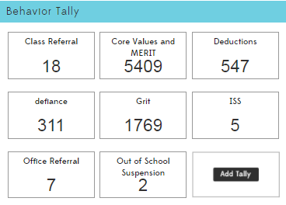

Slide 5
Class Referrals 16/17 vs. 17/18
Class Referrals have been reduced in 17/18 by 4% so far.
16/17 total: 150
17/18 total: 144

Slide 6
Office Referrals 16/17 vs. 17/18
Office referrals have dropped in 2017 by 70.7%
2016/17 total: 92
2017/18 total: 27

Slide 7
In-School Suspension 16/17 vs. 17/18
ISS has dropped in 2017 by 30.8%
2016/2017 total: 26
2017/2018 total: 18

Slide 8
Out of School Suspension 16/17 vs. 17/18
Suspension has dropped in 2017 by 60.0%
2016/17 total: 35
2017/18 total: 14

Slide 9
MERIT Rallies
December 15 is the Hard Work and Determination (GRIT) Rally.
This month we will recognize
High Honors
Honors
iReady Gold and Silver
Attendance
Grit (MERIT)
MERIT Store
Classes will run the MERIT store in house with leadership and or parent help

Slide 10
PBIS-
Rework behavior tracking: Kickboard and Behavior Plan to help fit three groups
K1, 4-6, and Middle School
Paraprofessionals
Indoor Recess with Playworks
Searching for Trainings

