Slide 1
Dean of Students
Board Report
December 2016

Slide 2
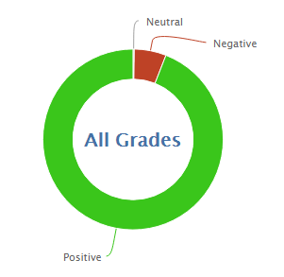
502
7,580
94.0% Positive from 12/1 through 12/13/2016

Slide 3
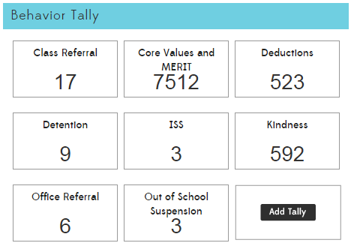

Slide 4

*

Slide 5
Interventions (student)
5 students are currently on behavior intervention plans
  2 students are showing improvement
  1 students are neutral, or is not showing improvement
  2 students are showing more negative behavior than the beginning of the behavior plan
5 students are working continuously in the garden/DMCS beautification on Wednesdays
  Some others volunteer or are assigned

Slide 6
PBIS and MERIT
PBIS
  The PBIS Team met to discuss the referral process.
  Referrals will be more uniform and should be more efficient when we get back from break
The Great Kindness Challenge
  In progress and going well, most students are working on their kindness check off sheets.
  593 kind behaviors have been recorded by teachers this month!

Slide 7
