Slide 1
Assembly Expectations
Be Safe, Be Responsible, Be Respectful!

Slide 2
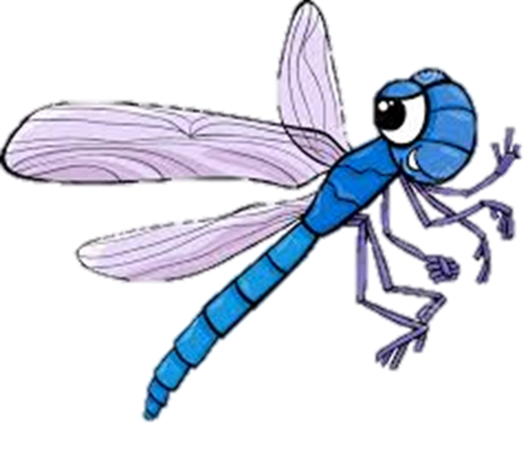
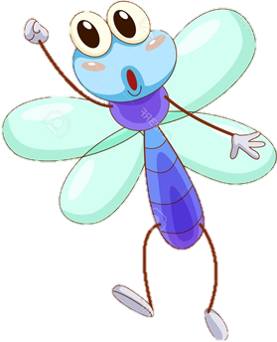
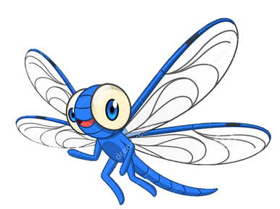
What it looks like to Be Safe
Wait for arrival and dismissal
Waiting patiently lets each group of people safely exit the building

Slide 3
What it looks like to Be Safe
Listen to adults
Adults are here to make sure you and your friends are safe, if they are talking… Listen

Slide 4
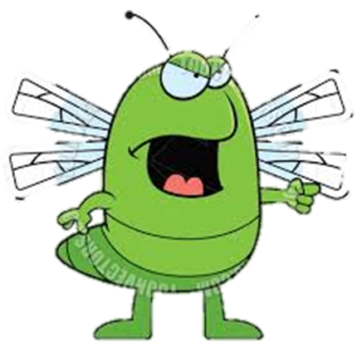
Be Respectful
Keep hands, feet and objects to yourself
People worked hard to make your assembly fun, show them some respect by paying attention

Slide 5
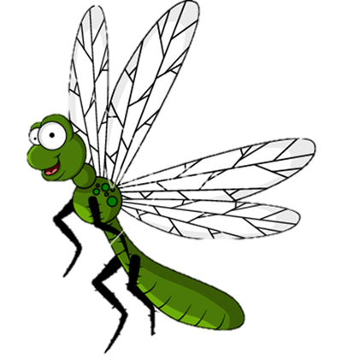
Be Respectful
Sit on your bottom
Standing up, or moving too much might block someone’s view

Slide 6
Be Responsible
Follow school rules
Assemblies are a GREAT time to be caught being good!

Slide 7
Be Responsible
Be honest
Show respect to people on the stage
They worked hard for you

Slide 8
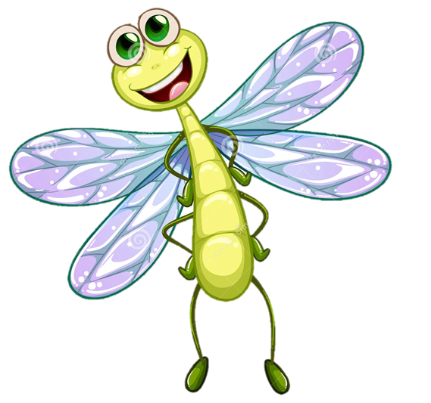
Kickboard Points!
Why is it important to behave appropriately in assemblies?
What comments or concerns do you have about assemblies?

