Slide 1
Kickboard For
Parents
Notes:
This slide deck outlines Kickboard’s overview for parents and families
Feel free to edit this PowerPoint for your school’s needs.

Slide 2
AGENDA
School goals
Kickboard overview
Our school’s Kickboard site
Kickboard and Parents

Slide 3
Our School Goals
Proactive discipline -Teach and enforce behavioral expectations before students have a chance to break a rule.
Increases communication – Teachers, parents and administrators will see what is happening with their student in real time.
Help Teachers with Discipline Strategies- Develop and implement scientifically proven behavioral interventions, to reinforce good choices and reduce bad choices.
Notes:
Fill in this slide with your school goals.
What goals is Kickboard supporting?
What kind of culture are you trying to achieve at your school?

Slide 4
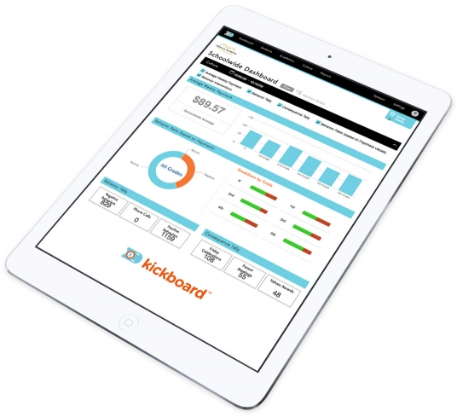
What is Kickboard?
Kickboard is a tool to reinforce positive behavior choices in real time.
Students earn or lose dollars (or points) for behavior choices throughout their day.
When a child changes classes, the next teacher and administrators can see that child’s behavior history from the day.
Kickboard shows trends in student behavior in order to receive positive and negative consequences
Kickboard offers school-wide consistency in expectations
Reports behavior data for staff and parents

Slide 5
Kickboard’s Data Privacy Policy
Although we hope it goes without saying, Kickboard will only use personally identifiable information from students’ education records to enable school officials and parents to access and use Kickboard.
Your child’s personally identifiable information is encrypted in transit to and from Kickboard.
In addition, all personally identifiable information is stored on secure servers behind firewalls by our hosting providers.
Consistent with guidance from the U.S. Department of Education, all the servers used by Kickboard are located in the United States.

Slide 6
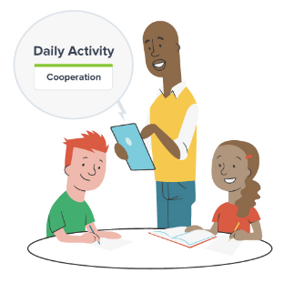
Kickboard At Our School
Dixon Montessori Charter School emphasizes two sets of expected behavior:
Be Safe, Be Responsible, Be Respectful
Motivated learning, Effective communication, Respectful Citizenship, Innovative Thinking, Technological Skill
DMCS teachers will give students points when students demonstrate the above positive behaviors. Points are converted to “MERIT Bucks” and are used to buy privileges at the student store.
Notes:
Give parents a quick overview of how Kickboard will be used at your school.
Maybe review what a “good” student report would include - i.e. 35 points per week or above is a good week - or describe how behaviors will be assigned in each classroom.
You may also want to review why you chose to use a point/dollar-based system for behavior

Slide 7
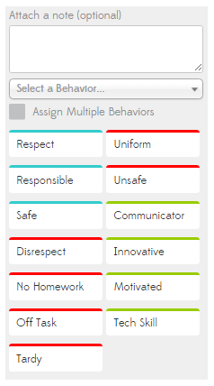
School-Wide Behaviors We Reinforce
Every time a teacher clicks a behavior, the student earns (or loses if the behavior is negative) one MERIT Dollar.
Every month one behavior will be highlighted, and worth two points/dollars. In September the behavior we will focus on is responsibility.
Notes:
Explain categories of behaviors, point values, and school-wide expectations
Pro tip: include a screenshot of your daily activity page

Slide 8
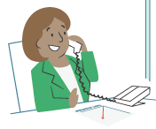
Parent Communication
DMCS parents and guardians will see paychecks and be connected to a parent-student portal.
Notes:
Fill in this slide with the ways your parents will receive Kickboard information.
Will you be sending home weekly student behavior reports?
Will you be using the Parent-Student Portal so that parents can see their child’s behavior in real time?
Pro tip: some schools use Kickboard to track parent involvement, rewarding students dollars/points for parent attendance at conferences, meetings, etc.

Slide 9
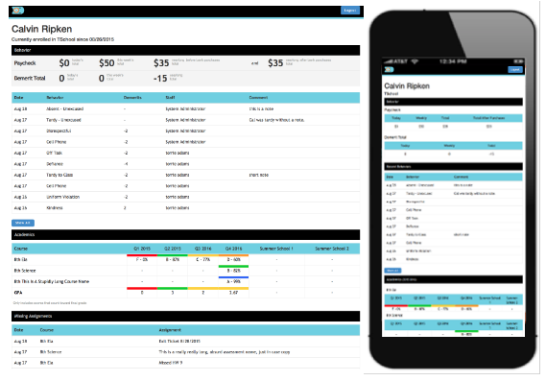
Parent Portal
The Kickboard Parent Portal displays:
Behavior – A summary of the student’s merit/demerit, paycheck, and bank balances.
Most Recent Behaviors – A list of the student’s behaviors recorded, listed chronologically.
Notes:
*Note: if you are not using Kickboard to track academics, those sections will still show on the parent portal with all fields blank.

Slide 10
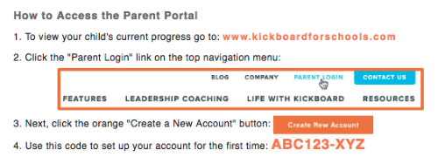
Parent Portal Login Instructions
Notes:
Review these instructions with parents. However, they are also written out on the access letters you will hand out to parents.

Slide 11
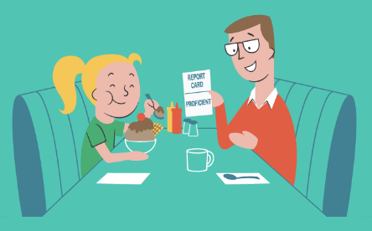
Guiding Questions to Ask Your Child
How do you think your week went?
Are you earning more positive behaviors?
How many dollars/points are you trying to earn next week?
What is your plan to earn more dollars next week?
Tell me about what happened when you earned this behavior.
Notes:
Use this slide to review how parents can use Kickboard information at home to reinforce your goals and expectations.

Slide 12
Questions?

