Slide 1
Dixon Montessori Charter School Universal Referral Guide

Slide 2
Who here understands the DMCS discipline policy?
Who has given a referral this year?
Who here should have given a referral, but did not?

Slide 3
Objectives
Explain the policy and logic for our discipline system
Define and categorize problem behaviors
Referral “How To”
Guidelines for responding to problem behavior
Kickboard data entry
Decision making process/follow through

Slide 4
PBIS Discipline System Goals
Increase consistency across the school.
Make school a predictable, consistent, positive environment for students.
Discipline always starts with teaching, prompting and acknowledging positive behavior
School-wide expectations and implications
Classroom expectations and implications
Individual student expectations and implications
http://dixonmontessorideanofstudents.weebly.com/discipline-at-dmcs.html

Slide 5
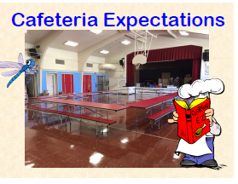
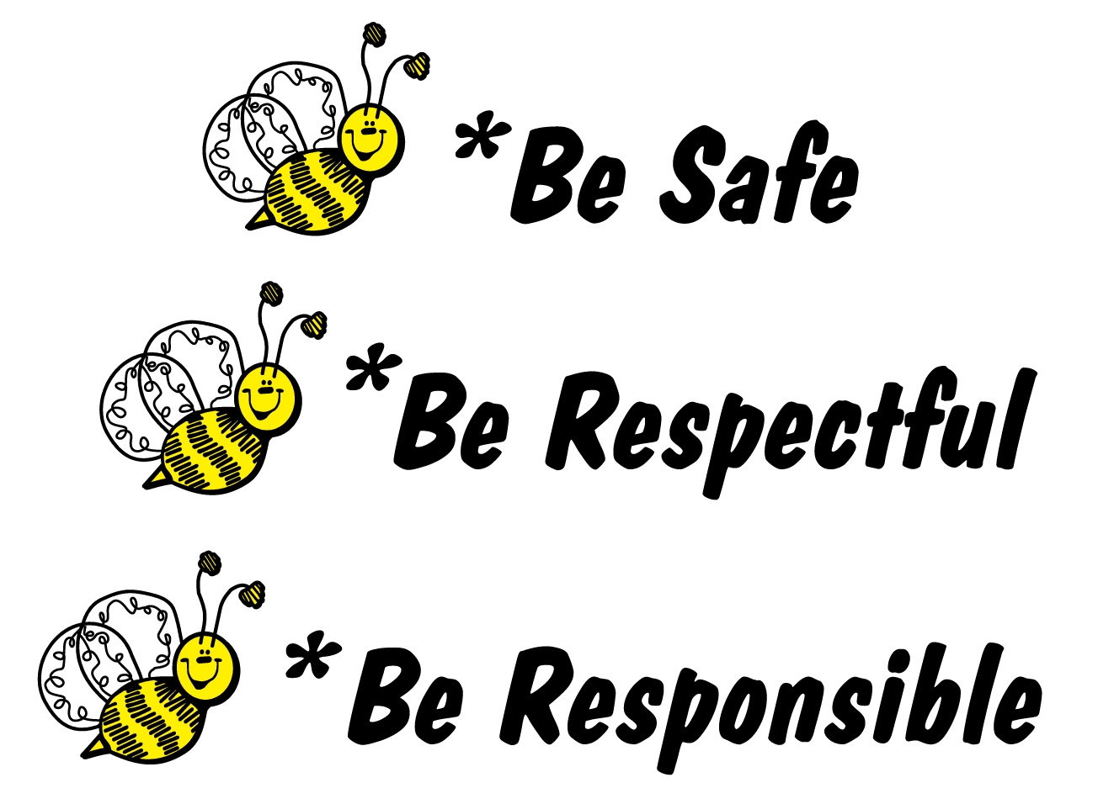
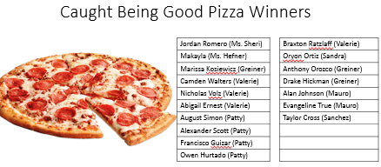

Slide 6
What happens when expectations are not met?
Delivering negative consequences for problem behavior is a necessary but insufficient strategy for reducing problem behavior.
Always define, teach and acknowledge expectations before you focus on negative consequences
Use negative consequences to achieve the following four functions:
Prevent a problem behavior from being rewarded
Prevent a problem behavior from escalating
Prevent a problem behavior from interrupting instruction for others
Provide a teaching opportunity (“this behavior is NOT being respectful”)

Slide 7
Consistency is Key
Students need to know how the adults at DMCS will react to their behavior.
Basic Structure
Try again, re-direction, de-escalation
Time out/break/removal from activity
“White Slip” or detention and loss of Kickboard point
Referral
Level three behaviors warrant an automatic referral

Slide 8
DMCS Behavior Flow Chart

Slide 9
Level 1 Consequences
“Try again”
Flip card to yellow
Give a negative on Kickboard
Speak with the teacher about reaching expectations
Write a White Slip

Slide 10
Level 2 Consequences
Write a Referral (an administrator will be there shortly)
Enter behavior on Kickboard
Give detention (MS)
Loss of Fun Friday or Lunch Recess (Elem)

Slide 11
Level 3 Consequence
Write a Referral and send the student to the office
-Every student has the right to learn! Stay calm, remain firm, remove the student with the problem behavior and continue to teach.
Follow up with office recommendations

Slide 12
How to write a referral
https://dmcs.kickboardforschools.com/culture/daily-activity
Relevant information
Who (select name on app, do not write other student names)
What (problem behavior, short and sweet)
When (what time of day is recorded by Kickboard)
Where (location))
Why (why does this keep happening)
Details
----------------------------------
Administrative Decision

Slide 13
Purposes of delivering a referral
Interrupt problem behavior
Prevent escalation
Teach discrimination about what is acceptable
“This is not being respectful”
Minimize likelihood that problem behavior will be rewarded.
Allow education to continue for others
Safety
Access to instruction

Slide 14
When do we use a referral?
Teachers have the authority to manage problem behavior in class (or with a partner)
Detention, Loss of Recess
Think-time
Time out (define Time out)
Use an office referral if a problem behavior (a) interferes with on-going education of others, (b) threatens safety, or (c) is of a severity requiring more extended intervention (e.g. more than 1 min).
Note that in-class interventions should also be included in the Kickboard data collection system… and are useful for decision-making

Slide 15
What to do after a referral
Once you enter a referral on Kickboard the office is automatically notified.
An administrator will determine a consequence
An administrator will follow through on the consequence and record decisions on Kickboard
The administrator will provide teacher feedback
The teacher will follow through with the recommended consequence

Slide 16
In-School Suspension Room
A student may be assigned In-School Suspension (ISS)
ISS ranges from one period to 5 days
If a student is assigned ISS, the teacher needs to provide work for the student.
Take concrete action to correct behavior in the future

