Slide 1
Kickboard Staff Training CULTURE
Notes:
This slide deck outlines Kickboard’s culture management functionality.
Feel free to edit this PowerPoint for your school’s needs.
All parts of the site should take about 90 minutes to introduce.

Slide 2
CULTURE TRAINING AGENDA
Why Kickboard?
Culture Data Entry
Consequences
Culture Data Entry Expectations
Groups?

Slide 3
Why Kickboard?
Kickboard helps shape student behavior
We are taking a proactive stance on discipline
Keep small problems small
Reinforce a common school culture
Increase communication between teachers, parents, administration, Paras, EDP, and students
Notes:
Why Kickboard?
Have leaders explain why they chose to bring Kickboard to their school this year. What are they trying to achieve with the support of Kickboard?
This is pretty much just a teacher-facing version of their goal

Slide 4
Logging In To Your Kickboard Site
(no www)
https://dmcs.kickboardforteachers.com
Username: first initial of first name + entire last name
Set Password: click “Forgot your password?”
Bookmark it!
Notes:
Have teachers navigate to their site and login. (Remember there is no “www” at the beginning of the web address)
TROUBLESHOOTING TIPS – you (the admin) can check each staff member’s username by navigating to settings → staff on your Kickboard site and clicking on anyone who is having trouble logging in. You can also reset their password and add their email address on that page.

Slide 5
Entering Culture Data
Logging Behavior Records in Kickboard
Notes:
Now we are going to learn how to get culture data into Kickboard.

Slide 6
Our Behaviors
Some of the behaviors we chose represent our Expected Schoolwide Learning Results (ESLRs) MERIT
Some match our school behaviors expectations Be Safe, Be Respectful, Be Responsible
Some… are negative, but represent a child making the choice to go against DMCS expectations
Notes:
Why did we choose the behaviors we chose?
Leaders should be able to tell their teachers - why do we want to know when students do these behaviors? What are we trying to achieve by tracking them? (decreasing the negatives, increasing positivity, etc.)
Insert a screenshot of your school’s Behavior List with dollar/point values (or print it out as a handout).

Slide 7
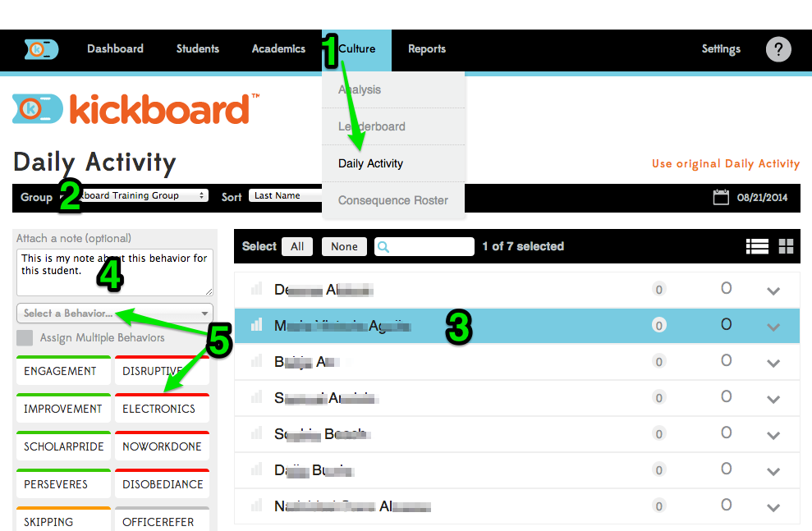
Entering Behavior Data
Notes:
Basics of Entering Behaviors:
Go to Culture > Daily Activity
Choose the student group
Select a student by clicking on his/her name
(Optional) Type a note
Select a behavior from the dropdown list or select a behavior quick-add button
Notice how the numbers next to the student change. Explain:
The number is the circle is the number of behaviors recorded today
The number on the end is the student’s point/dollar balance for the culture period (usually the week- more on this later)

Slide 8
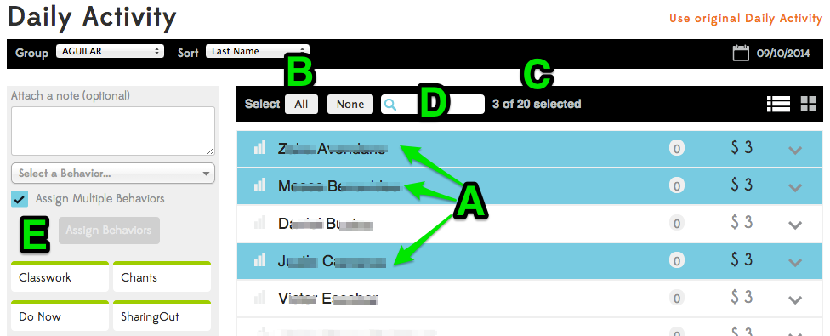
Behavior Entry Tips
Notes:
Present the following scenario(s):
1. What if you wanted to give 3 students a point for working together well- how would you do it? (select 3 kids, select behavior).
2. What if your whole class is on task except for 1 student? How could you reward the whole class except for that one? (Select All, Deselect 1 kid, select behavior)
Daily Activity Page Tips:
A. Select multiple students by clicking on multiple rows.
B. Select the whole group at once by clicking the “All” button. If needed, you could then deselect certain students by clicking on their individual rows.
C. A count of how many students are selected will appear in the small black banner.
D. To search for a student, start typing the name in search box with the magnifying glass icon.
E. Assign multiple behaviors at once by selecting a student, checking Assign Multiple Behaviors, choosing multiple quick buttons, then clicking Assign Behaviors.

Slide 9
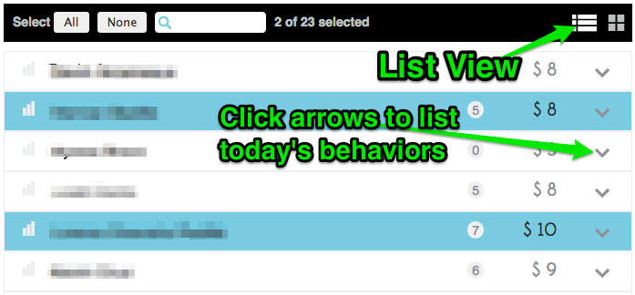
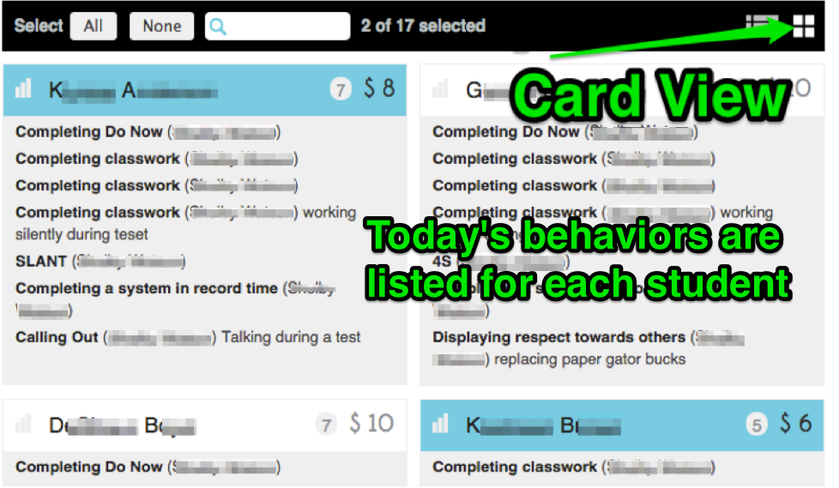
List View vs. Card View
Notes:
There are two ways to view students on Daily Activity- List View and Card View. Both share all the same functionality for entering behaviors.
List View is the default. Each student is represented by a row in a list. This means more students can fit on the screen, but seeing behavior details for the day require clicking the arrow to expand for each student.
Card View can be seen be clicking the 4-square window icon. Each student’s behavior details for the day are fully listed under their names, but this means fewer students can be seen on the screen at one time.

Slide 10
Our Consequences
Consequences are an automatic action caused by student behavior
We currently have one consequence, an office referral
BUT, we can make or change consequences when the need arises
Notes:
Why did we choose the consequences?
Same as above - what will these consequences and triggers help to achieve outside of the program?
List your school’s consequences along with the automated behavior rules for each.

Slide 11
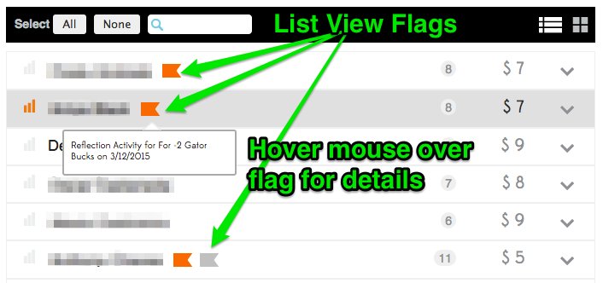
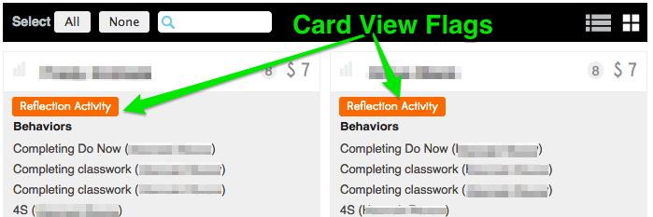
Consequence Flags
Notes:
When a student is added to a consequence roster (either automatically with a trigger or manually), a colored flag will appear next to their name on Daily Activity.

Slide 12
Consequence Rosters
Notes:
Explain how students are automatically added to rosters based on triggers and consequence assignment (today or next available day).
Show how you can look at different rosters by using the dropdown and how you can change the date for “fixed day” consequences (this is especially important if you have a consequence that only happens on certain days).
If your school wants teachers to manually add students to certain rosters, show them how to do this on this page by clicking Add Student to Roster.

Slide 13
Our Expectations for Culture Entry
We have two ways to enter data
1. On the computer or Chrome Book
2. On our phones
3:1 Ratio
Data needs to be entered ASAP
Notes:
What are your expectations for teacher usage?
Best practices: Encourage them to imagine what usage looks like in the classroom (tracking everything that the teacher says, or teacher redirects twice before tracking? Whole class points in the hallway?). This question is best thought of from the teacher perspective, then do the math to get to school-wide usage.

Slide 14
Students & Groups
Managing your student roster and organizing students into groups
Notes:
If you will be creating the groups for your teachers, review that they can create their own (pull out, tutoring, etc.) if they choose to, but you can skip that part of the training and just show them the groups that they have already been assigned to.
REMEMBER – data is attached to a student, not a group. Students can be in infinite groups and moved back and forth and it will not affect data that has been put in the system.

Slide 15
Our Plan for Groups
I have created class groups for you
Send an email to let me know if there are problems with your group
When the need arises, I will show you how to create groups on your own (homework club)
Notes:
Who is creating groups?
More of a planning question - do teachers need to know how to make groups? Do you need time during training for them to make their groups?

Slide 16
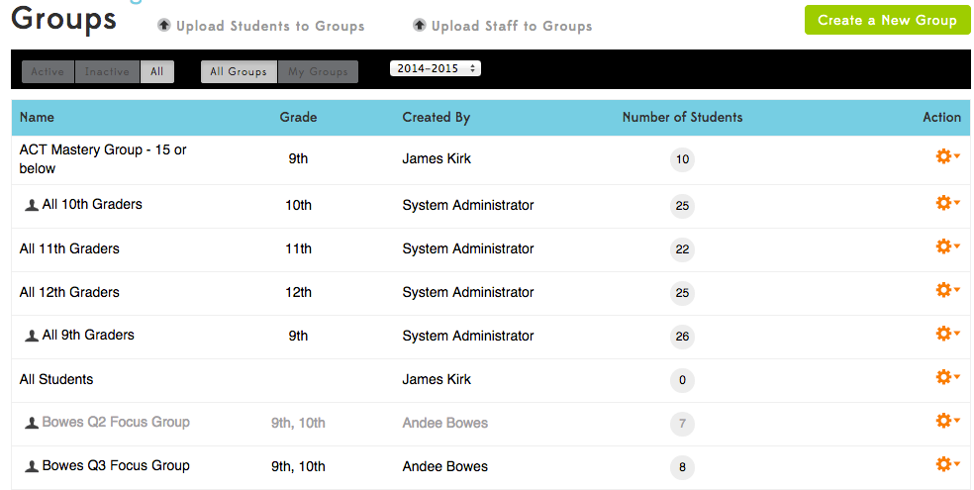
Student Groups
Students → Groups
Notes:
What are groups?
Groups are how your students are organized in Kickboard to facilitate data entry.
The most common groups are Grade Level groups, Homeroom/Advisory groups, and Class Period groups.
Some schools create tutoring groups, after-school club groups, focus groups, etc.
Students can be in as many groups as they need to be in and teachers can have access to as many different groups of students as needed.
Groups can be created at any time by teachers or admins

Slide 17
Managing your Groups
Notes:
Briefly mention that this page also has a black filter banner with more options, like “My Groups”
Then discuss the action cog options:
Add/remove myself (Admins can access all groups throughout the site, but teachers can only access the groups they are a member of)
Edit (admins can edit any group, teacher can only groups they are a member of)
Teachers that teach the same cohort of students don’t need to both create groups, they can just create one and add themselves to it.

Slide 18
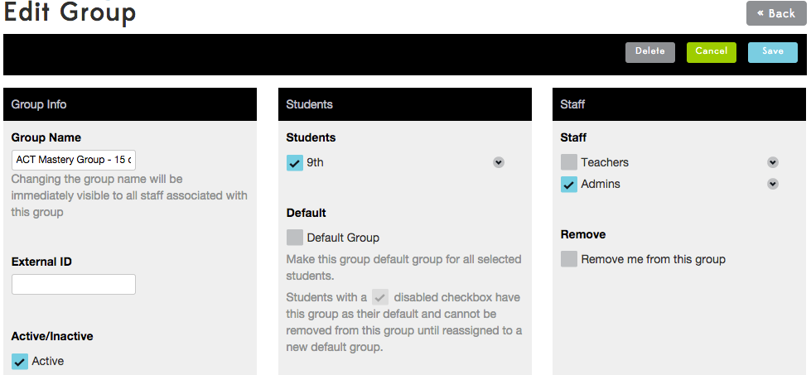
Creating & Editing Groups
Notes:
Create a New Group (another big green button!)
Select Grade(s)- groups can contain students from multiple grade levels, if needed.
Move to Students column
Click the expand arrow next to grade level
All students selected by default- click grade level check box to deselect all
Select specific students for this group
Default Groups- Each student has 1 default group. This is usually the group you would want to hand out printed reports to, like a homeroom or advisory.
Move to Staff Column (admin only, teachers can only see whose assigned, not change it)
Click Create New Group
Editing a group uses the same interface- click edit under the action cog, make changes, save.

Slide 19
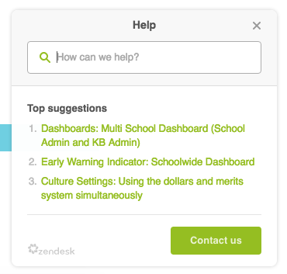
Resources
Notes:
? – links to help articles about the page you are currently viewing. At the bottom of the menu the “Explore the Knowledgebase” link will take you to Kickboard University – an archive of all help articles and directions from Kickboard. The “Ask a Question” link will create an email sent directly to our tech support test with a screenshot of the page you are viewing (for technology troubleshooting)

Slide 20
iOS Mobile App
Search Kickboard in the App Store
Only available for iPhones and iPads
Android version in development
Log in with your school email address and Kickboard password
Record behaviors in real time!

Slide 21
Questions?

