Slide 1
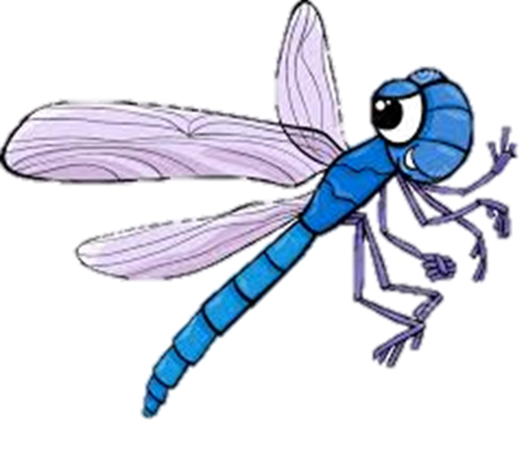
Class
Expectations
Be Safe
Be Respectful
Be Responsible

Slide 2
Be Respectful
Say please and thank you
Use table manners if there is food
Present yourself cleanly and dress well
Keep your voice peaceful and polite

Slide 3
Be Safe
Walk at all times
Move peacefully from one place to the other
Have helping hands

Slide 4
Be Responsible
Follow normal class expectations
Leave your area cleaner than you found it
Smile and treat others well
Bring a gift for your teacher if you want

Slide 5
Be Safe, Responsible and Respectful!

