Slide 1
Dean of Students Board Report
September 2017

Slide 2
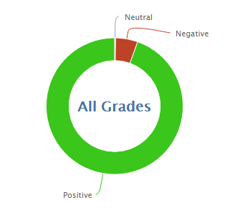
1089
14169
92.5% Positive for the month of September so far
94.7% was the average for September last year

Slide 3
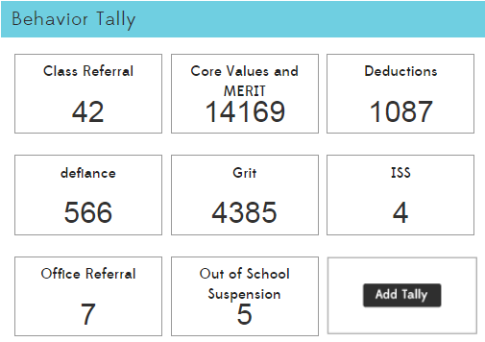

Slide 4
87.5% of suspension and ISS are from new students this month. Behavior plans and tracking are currently in place.

Slide 5
MERIT
MERIT Rallies
September is Responsibility month.
Leadership has formed and is creating the rally
6th grade is doing a puppet show about responsibility
5 Students from Leadership
MERIT Store
Plan schedule for next year
Find students to run the store (leadership is changing)
MERIT Checks are printed and have been sent home by most teachers
Most teachers have created MERIT Store items
5 Students from leadership

Slide 6
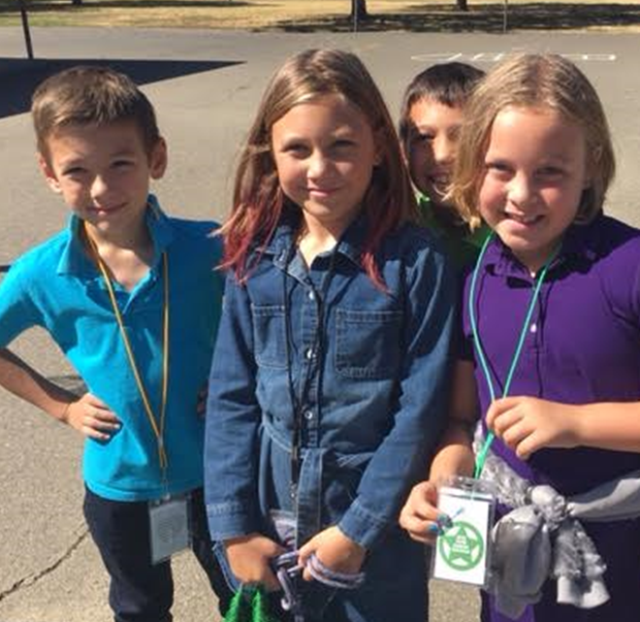
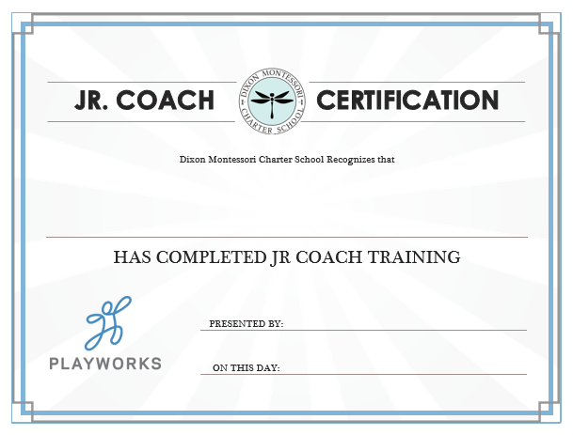
PBIS-Playworks Recess Implementation
Mr. Riemer and Ms. Kim are doing an amazing job as PE teachers and coaches
Recess Rockstars were brought to the recess program in September
❏ Rock Paper Scissors Rockstar
I am in charge of reminding people to play Rock Paper Scissors when there is a disagreement in a game. No disagreements? My role is to walk around and challenge other students to Rock Paper Scissors.
❏ Lightning Lingo Rockstar:
❏ Equipment Rockstar:
❏ High-Five Rockstar:
❏ Get-in-the-Game Rockstar:

Slide 7
PBIS Team
Classroom Management 1
Developed by the PBIS team
Halloween theme for fun
The PBIS Team has met twice this year
Energize positive academics and behavior
Do not energize negative choices

