Slide 1
Dean of Students Board Report
May 2017

Slide 2
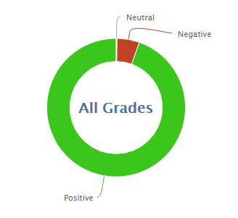
1065
13030
92.4% Positive from 4/25-5/23

Slide 5
MERIT
MERIT Rally
Awards!
Honors/High Honors
Kickboard Point Leaders
MERIT Store
The last MERIT store opportunity will be next Tuesday!
I will be at a “Leader in Me” open house in Sacramento for part of our store time.

Slide 6
PBIS
Looking forward to starting a new year with a great PBIS team and a more complete behavior management system.
Currently looking for a great PBIS training

Slide 7
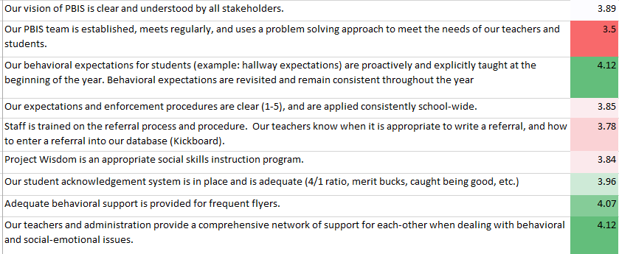
PBIS Survey

