Slide 1
Dean of Students Board Report
March 2017

Slide 2
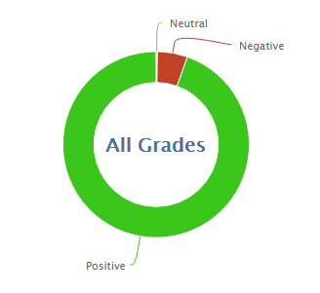
1373
18450
93.1% Positive from 3/1-3/27

Slide 3
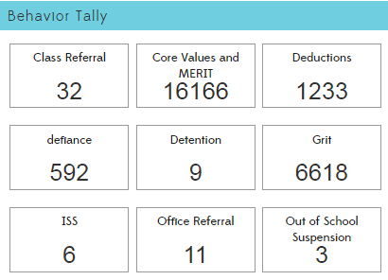

Slide 5
PBIS and MERIT
MERIT Rally
Teamwork and Cooperation
Awards for last month’s character trait (Confidence)
Presentation by our chorus
Game involving teachers
Announcement of honor roll
Crazy Hair Day
Reteach Expectations
Begin to talk about positivity boosts for spring

