Slide 1
Dean of Students Board Report
End of Year 2017

Slide 2
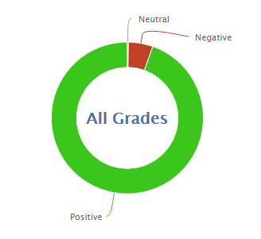
10,250
157,845
93.9% Positive for the 2016/17 School Year

Slide 3
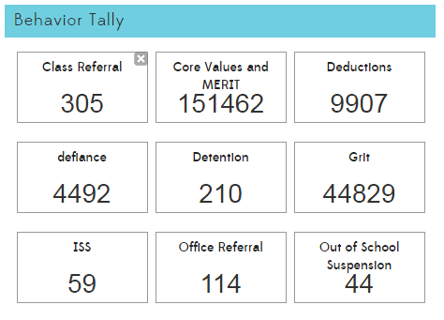

Slide 5
MERIT
MERIT Rallies
Build a new Kickoff Rally
Rework End of Year Rally
Make all rallies more efficient
Quicker call to attention- SLANT
Engaging activities
Less instructional time missed
MERIT Store
Plan schedule for next year
Find students to run the store (leadership is changing)
Purchase items for kindness challenge and end of year prizes.

Slide 6
PBIS
New team consists of Ms. Heather, Ms. Melissa, Ms. Sandra, Ms. Jaime, Ms. Gena, and Ms. Tawny
Meeting dates and times are scheduled for next year
Currently looking for a great PBIS training
Leader in Me, Responsive Classroom, El Dorado SELPA
Student Lessons
Simplify the Matrix
Rework to include expectations, encouragements, and enforcements

Slide 7
Teacher Lessons
Behavior 1+2
Behavior Management Steps 1-5
CPI
Kickboard Review
Referral Procedure
Leader in Me, Responsive Classroom, ?

Slide 8
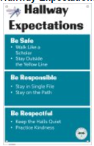
PBIS Posters

Slide 9
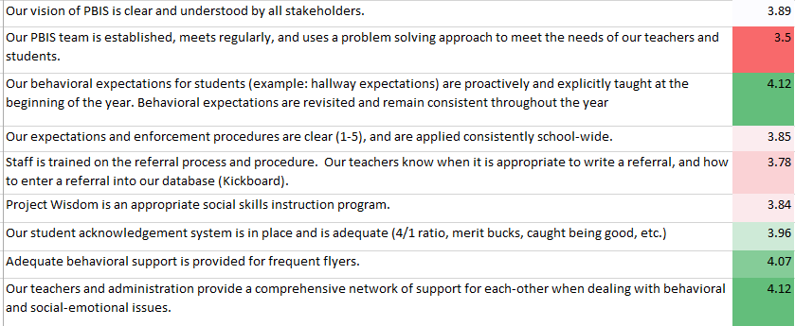
PBIS Survey

