Slide 1
Dean of Students Board Report
February 2018

Slide 2
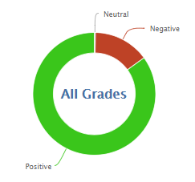
1,992
14,350
86.1% Positive for the month of February so far
91.7% was the average for February last year

Slide 3
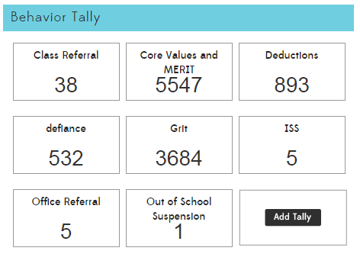

Slide 5
Class Referrals 16/17 vs. 17/18

Slide 6
Office Referrals 16/17 vs. 17/18

Slide 7
In-School Suspension 16/17 vs. 17/18
All between 2/1 and 2/6

Slide 8
Out of School Suspension 16/17 vs. 17/18

Slide 9
MERIT Rallies
January 22 was the Kindness Kickoff
In February we recognized
Outstanding students for Kindness
Kindness Ambassadors
MERIT Awards for Honesty

Slide 10
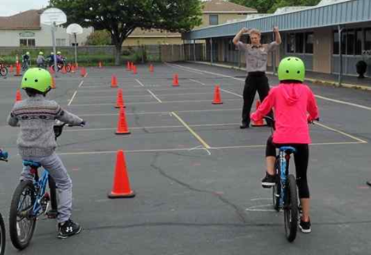
PTA + PBIS Bicycle Rodeo
March 16:
1:00-3:00 Ms. Kemp, 4th, 5th
March 23:
12:45-2:45 Ms. Autumn
12:30-2:30 All 2/3 Classes

