Slide 1
Dean of Students Board Report
January and February 2017

Slide 2
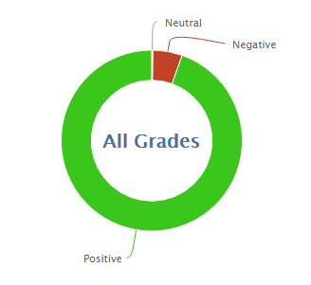
1734
19168
91.7% Positive from 1/17 through 2/21/17

Slide 3
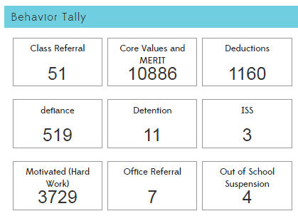

Slide 5
Interventions (student)
7 students are currently on behavior intervention plans
24 BIPs have been used
5 students are working continuously in the garden/DMCS beautification on Wednesdays
Some others volunteer or are assigned

Slide 6
PBIS and MERIT
PBIS
Our new School Management Plan is operational.
Our expectations and enforcement procedures are now the same in every class, the MPR, and EDP.
Every class has a poster of Expectations and Enforcement on the wall
A letter to parents was sent home explaining the new school-wide expectations
Teacher Comments

Slide 7
