Slide 1
Dean of Students Board Report
August 9-17 2017

Slide 2
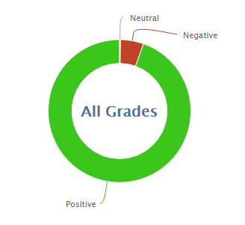
41
824
95.2% Positive for the month of August so far
93.9% was the average last year

Slide 3
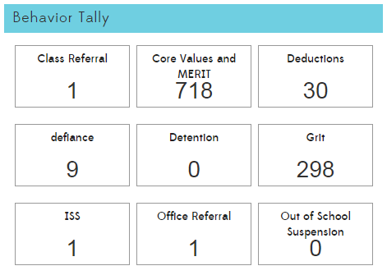

Slide 5
MERIT
MERIT Rallies
Kick off Rally
MERIT Store
Plan schedule for next year
Find students to run the store (leadership is changing)
Purchase items for kindness challenge and end of year prizes.

Slide 6
PBIS
New team consists of Ms. Heather, Ms. Melissa, Ms. Sandra, Ms. Jaime, Ms. Gena, and Ms. Tawny
Meeting dates and times are scheduled for next year
Currently looking for a great PBIS training
Leader in Me, Responsive Classroom, El Dorado SELPA
Student Lessons
Simplify the Matrix
Rework to include expectations, encouragements, and enforcements

Slide 7
Teacher Lessons
Behavior 1+2
Behavior Management Steps 1-5
CPI
Kickboard Review
Referral Procedure
Leader in Me, Responsive Classroom, ?

Slide 8
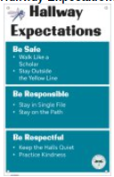
PBIS Posters

