Slide 1
Dean of Students Board Report
April 2017

Slide 2
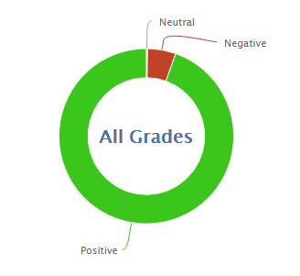
978
11616
92.2% Positive from 3/28-4/24

Slide 3
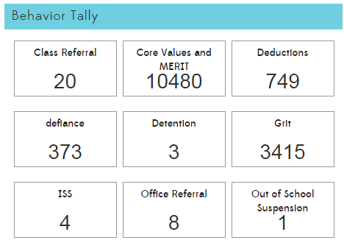

Slide 5
PBIS and MERIT
MERIT Rally
Self Respect and Self Discipline (Test Prep)
Stanford’s Marshmallow experiment
Ways to increase self discipline
Awards for last month’s character trait (Teamwork)
Reteach Expectations
Restroom, hallway, assembly, arrival (next week with solar panels), dress code, etc
Keep teachers focused on positive reinforcement of expectations
PBIS Survey

