Slide 1
Arrival
� Be Respectful
� Be Responsible
� Be Safe

Slide 2
Be Respectful
Be polite and cooperate with others.

Slide 3
Follow Directions
� Teachers and other adults help you stay safe, so pay attention

Slide 4
Be Responsible
Arrive on time:
Supervision starts at 7:45
Leave on time:
You will be released between 12:15 and 3:05
Make sure to check YOUR bell schedule

Slide 5
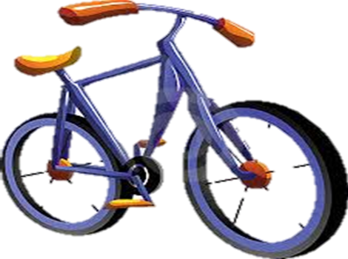
Walk safely
� Walk bicycles, scooters, and skateboards while on the sidewalk
� Park bikes in the bike racks
� Watch for moving vehicles

Slide 6
Phone Use
� Get a teacher’s permission to use any phone on campus

Slide 7
Be Safe
� You must remain on campus once you arrive
� Remain in designated areas until you are called to class
Kindergarden-1st
2nd and 3rd Grade
4th and 5th
Middle School

Slide 8
Dismissal
� If you are being picked up, wait for your ride.
� If you are walking, be aware of your surroundings
K-1 must be with a parent

